Slide 1
Programming Methodology Using ‘C’
Master of Computer Applications TMC 101

Slide 2
Syllabus
UNIT-1: Basic Programming Concepts: Basics of Problem-solving Tools, Program Design Methodology, Pseudo Code, Flowcharts, Algorithms, Translators, Programming Paradigms, Programming Languages and their Characteristics.
Introduction to C Language: History of C and its characteristics, Character Set, Identifiers, Variables, Assigning a Name to a Variable, Variable Declarations, Keywords, Tokens, Data Types, Constants, String Constant, Numeric Constant, Structure of C Program, Comment styles in ‘C’, Storage classes, type conversion.
UNIT-2 : Operators and Input/output: Instruction and its Types, Operators and Hierarchy of Operations, Bitwise operators, Expressions in C, Formatted and unformatted Input/output.
Flow Control: Control and Repetitive Statements, break, continue, Local and Global Variables.
UNIT-3 Function and Arrays: User defined functions and library functions, Recursion and Recursive Function, Call by Value Versus Call by Reference, parameter passing, arrays and functions,1D and 2D arrays

Slide 3
Syllabus
UNIT-4: Strings: Declaring and initialing string variables, reading and writing of string, string handling functions.
Pointers: Need of pointers, Pointer Arithmetic, Pointer to Pointer, Pointer and Arrays, Pointers and Function, Array of pointers, Dynamic memory management.
UNIT-5: Structure and Union: self-referential structures, pointer to structures.
File: Types of files, various modes to open a file. Writing and Reading data, random access of files, command line arguments.
Preprocessor Directives.

Slide 4
Control Statements
In C programs, statements are executed sequentially in the order in which they appear in the program. But sometimes we may want to use a condition for executing only a part of program. Also many situations arise where we may want to execute some statements several times. Control statements enable us to specify the order in which the various instructions in the program are to be executed. This determines the flow of control. Control statements define how the control is transferred to other parts of the program. C language supports four types of control-statements, which are as
if...else
goto
switch
loop (while, do...while , for)

Slide 5
Compound Statement or Block
A compound statement or a block is a group of statements enclosed within a pair of curly braces { } The statements inside the block are executed sequentially. The general form is
{
statementl;
statement2;
……….
…………. }
For example
{ l=4;
b=2;
area=l*b;
printf("%d",area) ;
}
A compound statement is syntactically equivalent to a single statement and can appear anywhere in the program where a single statement is allowed.

Slide 6
if...else
This is a bi-directional conditional control statement.
This statement is used to test a condition and take one of the two possible actions.
If the condition is true then a single statement or a block of statements is executed (one part of the program), otherwise another single statement or a block of statements is executed (other part of the program).
nonzero value is regarded as true while zero is regarded as false.

Slide 7
if(condition)
{
Statements;
………
}
if(condition)
Statement l;

Slide 8
if(condition)
{
statement;
………..
}
else
{
statement;
……….
}
if(condition)
statement l;
else
statement 2 ;

Slide 9
Program to print a message if negative number is entered
#include<stdio.h>
void main ( )
{
int num;
printf("Enter a number”);
scanf("%d“, &num};
if (num<0)
printf ("Number entered is negative);
}

Slide 10
if ( a = 10 )
printf ( "Even this works" ) ;
if ( -5 )
printf ( "Surprisingly even this works" ) ;
In the first if, 10 gets assigned to a so the if is now reduced to if ( a ) or if ( 10 ). Since 10 is non-zero, it is true hence again printf( ) goes to work.
In the second if, -5 is a non-zero number, hence true. So again printf( ) goes to work. In place of -5 even if a float like 3.14 were used it would be considered to be true

Slide 11
The current year and the year in which the employee joined the organization are entered through the keyboard. If the number of years for which the employee has served the organization is greater than 3 then a bonus of Rs. 2500/- is given to the employee. If the years of service are not greater than 3, then the program should do nothing.

Slide 12
/* Calculation of bonus */
void main( )
{ int bonus, cy, yoj, yr_of_ser ;
printf ( "Enter current year and year of joining " ) ;
scanf ( "%d %d", &cy, &yoj ) ;
yr_of_ser = cy - yoj ;
if ( yr_of_ser > 3 )
{ bonus = 2500 ;
printf ( "Bonus = Rs. %d", bonus ) ;
}
}

Slide 13
Program to print the larger and smaller of the two numbers
if (a>b)
printf(“a is largest”)
else
printf(“b is largest”);

Slide 14
In a company an employee is paid as under:
If his basic salary is less than Rs. 1500, then HRA = 10% of basic salary and DA = 90% of basic salary. If his salary is either equal to or above Rs. 1500, then HRA = Rs. 500 and DA = 98% of basic salary. If the employee's salary is input through the keyboard write a program to find his gross salary.

Slide 15
/* Calculation of gross salary */
main( )
{
float bs, gs, da, hra ;
printf ( "Enter basic salary " ) ;
scanf ( "%f", &bs ) ;
if ( bs < 1500 )
{
hra = bs * 10 / 100 ;
da = bs * 90 / 100 ; }
else
{
hra = 500 ;
da = bs * 98 / 100 ;
}
gs = bs + hra + da ; printf ( "gross salary = Rs. %f", gs ) ;
}

Slide 16
Nesting of if...else
if (condition 1)
{
if (condition 2)
statement A1;
else
statement A2;
}
else
{
if(condition 3)
statement B1
else
statement B2;
}

Slide 17
Program to find largest number from three given numbers
#include<stdio.h>
main( )
{ int a,b,c,large;
printf ("Enter three· numbers ") ;
scanf("%d%d%d",&a,&b,&c) ;
if (a>b)
{ if(a>c)
large=a;
else
large=c;
}
else
{ if (b>c)
large=b;
else
large=c;
}
printf(largest number is %d\n", large) ; }
Notes:
Program to find largest number from three given numbers

Slide 18
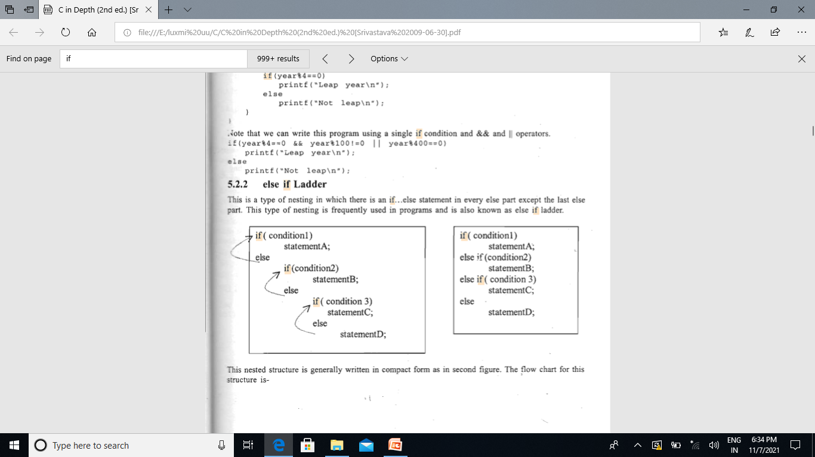
else if Ladder
This is a type of nesting in which there is an if. ..else statement in every else part except the last else part. This type of nesting is frequently used in programs and is also known as else if ladder.
Here each condition is checked, and when a condition is found to be true, the statements corresponding to that are executed, and the condition comes out of the nested structure without checking remaining conditions. If none of the conditions is true then the last else part is executed

Slide 19
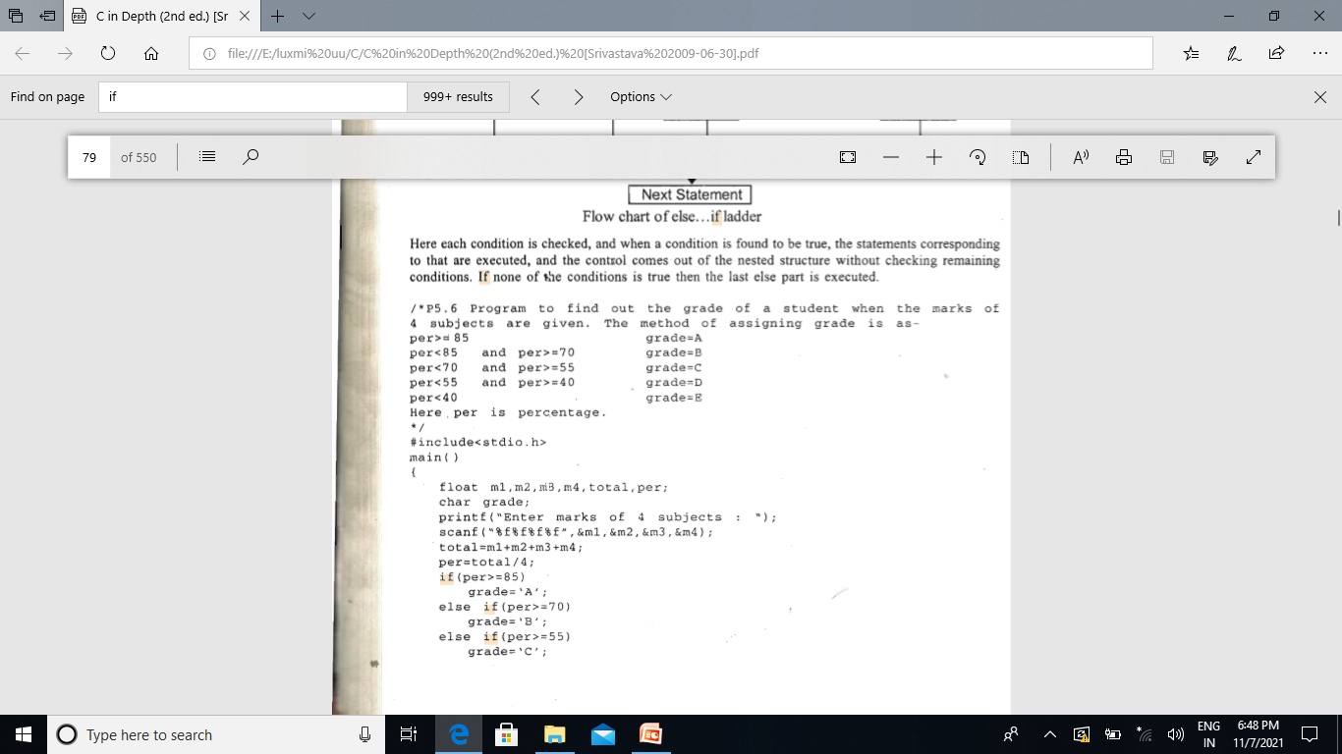
if (per>=85)
grade= 'A' ;
else if(per>=70)
grade='B';
else if (per>=55)
grade= 'C' ;
else if (per>=40)
grade= 'D' ;
else
grade='E';

Slide 20
Switch Case
switch (expression)
​{
case constant1:
// statements
break;
case constant2:
// statements
break;
.
.
.
default:
// default statements
}
The switch expression must be of an integer or character type.
2) The case value must be an integer or character constant.

Slide 21
int x,y,z;
char a,b;
float f;
Valid Switch | Invalid Switch | Valid Case | Invalid Case
switch(x) | switch(f) | case 3 | case 2.5
switch(x>y) | switch(x+2.5) | case 'a' | case x error: case label does not reduce to an integer constant
switch(a+b-2) |  | case 1+2 | case x+2
switch(func(x,y)) |  | case 'x'>'y' | case 1,2,3

Slide 22
*Program that demonstrate switch-case-default*/
void main()
{
int ch;
float n1,n2,res=0;
clrscr();
printf("\n\n **************** WELCOME TO THE WORLD OF MATHEMATICS************");
printf("\n\n\t1.) Addition");
printf("\n\t2.) Subtraction");
printf("\n\t3.) Multiplication");
printf("\n\t4.) Division");
printf("\n\t5.) Exit");
printf("\n\n Enter your choice from the list: ");
scanf("%d",&ch);
printf("\n Enter the values for two numbers:");
scanf("%f%f",&n1,&n2);
switch(ch) {
case 1:
res=n1 + n2;
break;

Slide 23
case 2:
res=n1 - n2;
break;
case 3:
res=n1 * n2;
break;
case 4:
res=n1 / n2;
break;
case 5:
exit(0);
default:
printf("\n You Entered wrong choice. \n");
}
printf("\n The result of operation is=%f",res);
printf("\n\n\n Press any key to goto the source code! ");
getch();
}

Slide 24
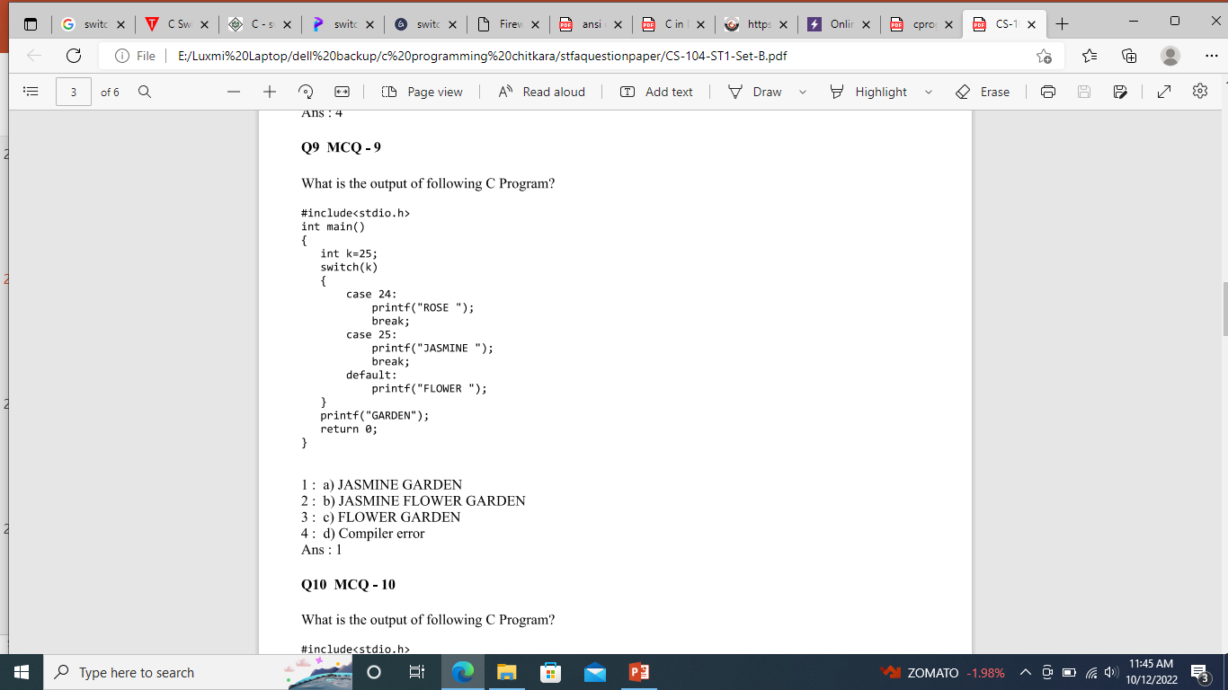
Notes:
Ans 1

Slide 25
C program to check vowel or consonant using switch case
int main()
{ char ch; /* Input an alphabet from user */
printf("Enter any alphabet: ");
scanf("%c", &ch); /* Switch value of ch */
switch(ch)
{
case 'a': printf("Vowel");
break;
case 'e': printf("Vowel");
break;
case 'i': printf("Vowel");
break;
case 'o': printf("Vowel");
break;
case 'u': printf("Vowel");
break;
case 'A': printf("Vowel");
break;
case 'E': printf("Vowel");
break;
case 'I': printf("Vowel"); break;
case 'O': printf("Vowel"); break;
case 'U': printf("Vowel"); break;
default: printf("Consonant"); } return 0; }

Slide 26
loops
The versatility of the computer lies in its ability to perform a set of instructions repeatedly. This involves repeating some portion of the program either a specified number of times or until a particular condition is being satisfied.
This repetitive operation is done through a loop control instruction . There are three methods
(a) Using a for statement
(b) Using a while statement
(c) Using a do-while statement

Slide 27
While loop
initialize loop counter ;
while ( test loop counter using a condition )
{ do this ;
and this ;
increment loop counter ;
}

Slide 28
Program to print the numbers from 1 to 10 using while. loop
void main()
{
int i=l;
while(i<=10)
{
printf("%d\t“,i) ;
i=i+1;
}

Slide 29
Write a program to calculate the sum of first 10 numbers
void main()
{
int i=0,sum=0;
while (i<=10)
{
sum=sum+i;
i=i+1; //condition updated
}
Printf(“\n sum =%d”,sum)
}

Slide 30
Program to print numbers in reverse order with a difference of 2
int k=10;
while(k>=2)
{
printf("%d\t,k);
k=k-2;
}
Output 10 8 6 4 2

Slide 31
Program to' print the sum of digits of any number
void main()
{
int n, sum=0, rem
printf ("Enter the number”)
scanf("%d, &n);
while(n>0)
{
rem=n%10 //taking the last digit of the number
sum=sum+rem;
n=n/10 //skipping last digit
}
printf ("Sum of digits = %d\n, sum) ;
}
output: Enter the number: 1452 Sum of digits = 12

Slide 32
Program to find the product of digits of any number
void main() {
int n,prod=l, rem;
printf ("Enter the number :");
scanf("%d",&n) ;
while(n>0)
{ rem=n%10;
prod=prod *rem;
n=n/10;
}
printf("Product of digits = %d\n",prod);
}
Output:
Enter the number : 234
Product of digits = 24

Slide 33
Program to find the factorial of any number
{
int n, num;
long fact=l;
printf ("Enter the number :”)
scanf("%d" ,&n);
num=n;
if(n<0)
printf ("No factorial of negative number\n");
else
{ while (n>1)
{
fact=fact *n;
n- - ;
}
printf ("Factorial of %d =%ld\n”,num,fact);
}
}
Output:
Enter the number: 4
Factorial of 4 = 24

Slide 34
do...while loop
#include <stdio.h>
int main()
{
int j=0;
do
{ printf("Value of variable j is: %d\n", j);
j++;
}
while (j<=3);
return 0;
}
do
{
//Statements }
while(condition test);

Slide 35
While vs do..while loop in C
#include <stdio.h>
int main()
{ int i=0;
while(i==1)
{
printf("while vs do-while");
}
printf("Out of loop");
}
Output:
Out of loop
#include <stdio.h>
int main()
{
int i=0;
do
{
printf("while vs do-while\n");
}
while(i==1);
printf("Out of loop");
}
Output:
while vs do-while
Out of loop

Slide 36
do-while runs at least once even if the condition is false because the condition is evaluated, after the execution of the body of loop.

Slide 37
Entry Control Loop the test condition is checked first and if that condition is true then the block of the statement will be executed,
While in Exit control loop first executes the body of the loop and checks condition at last.

Slide 38
Add numbers until the user enters zero
#include <stdio.h> I
int main()
{
double number, sum = 0;
do
{
printf("Enter a number: ");
scanf("%lf", &number);
sum += number;
}
while(number != 0.0);
printf("Sum = %. lf",sum);
return 0;
}

Slide 39
For Loop
for( expressionl; expression2; expression3)
{ statement
statement
}
Expressionl is an initialization expression
expression2 is a test expression or condition
eexpression3 .is an update expression
expression1 is executed only once when the loop starts and is used to Initialize the loop variables. This expression is generally an assignment expression. Expression2 is a condition and is tested before each iteration of the loop. This condition generally uses relational and logical operators. Expression3 is an update expression and is executed each time after the body of the loop is executed.

Slide 40
Write a C program to print all natural numbers from 1 to n.
Write a C program to print all natural numbers in reverse (from n to 1).
Write a C program to print all alphabets from a to z.
Write a C program to print all even numbers between 1 to 100
Write a C program to print all odd number between 1 to 100.
Write a C program to find sum of all natural numbers between 1 to n.
Write a C program to find sum of all even numbers between 1 to n.
Write a C program to find sum of all odd numbers between 1 to n.
Write a C program to print multiplication table of any number.

Slide 41
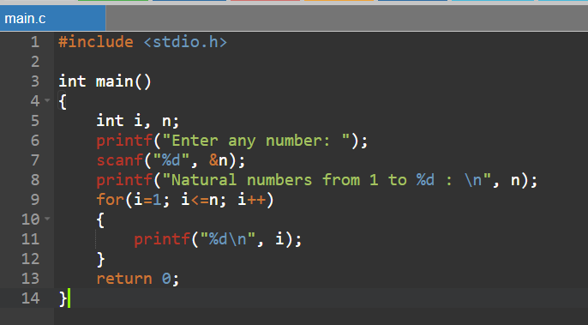
Write a C program to print all natural numbers from 1 to n.

Slide 42

Write a C program to print all natural numbers in reverse (from n to 1).

Slide 43
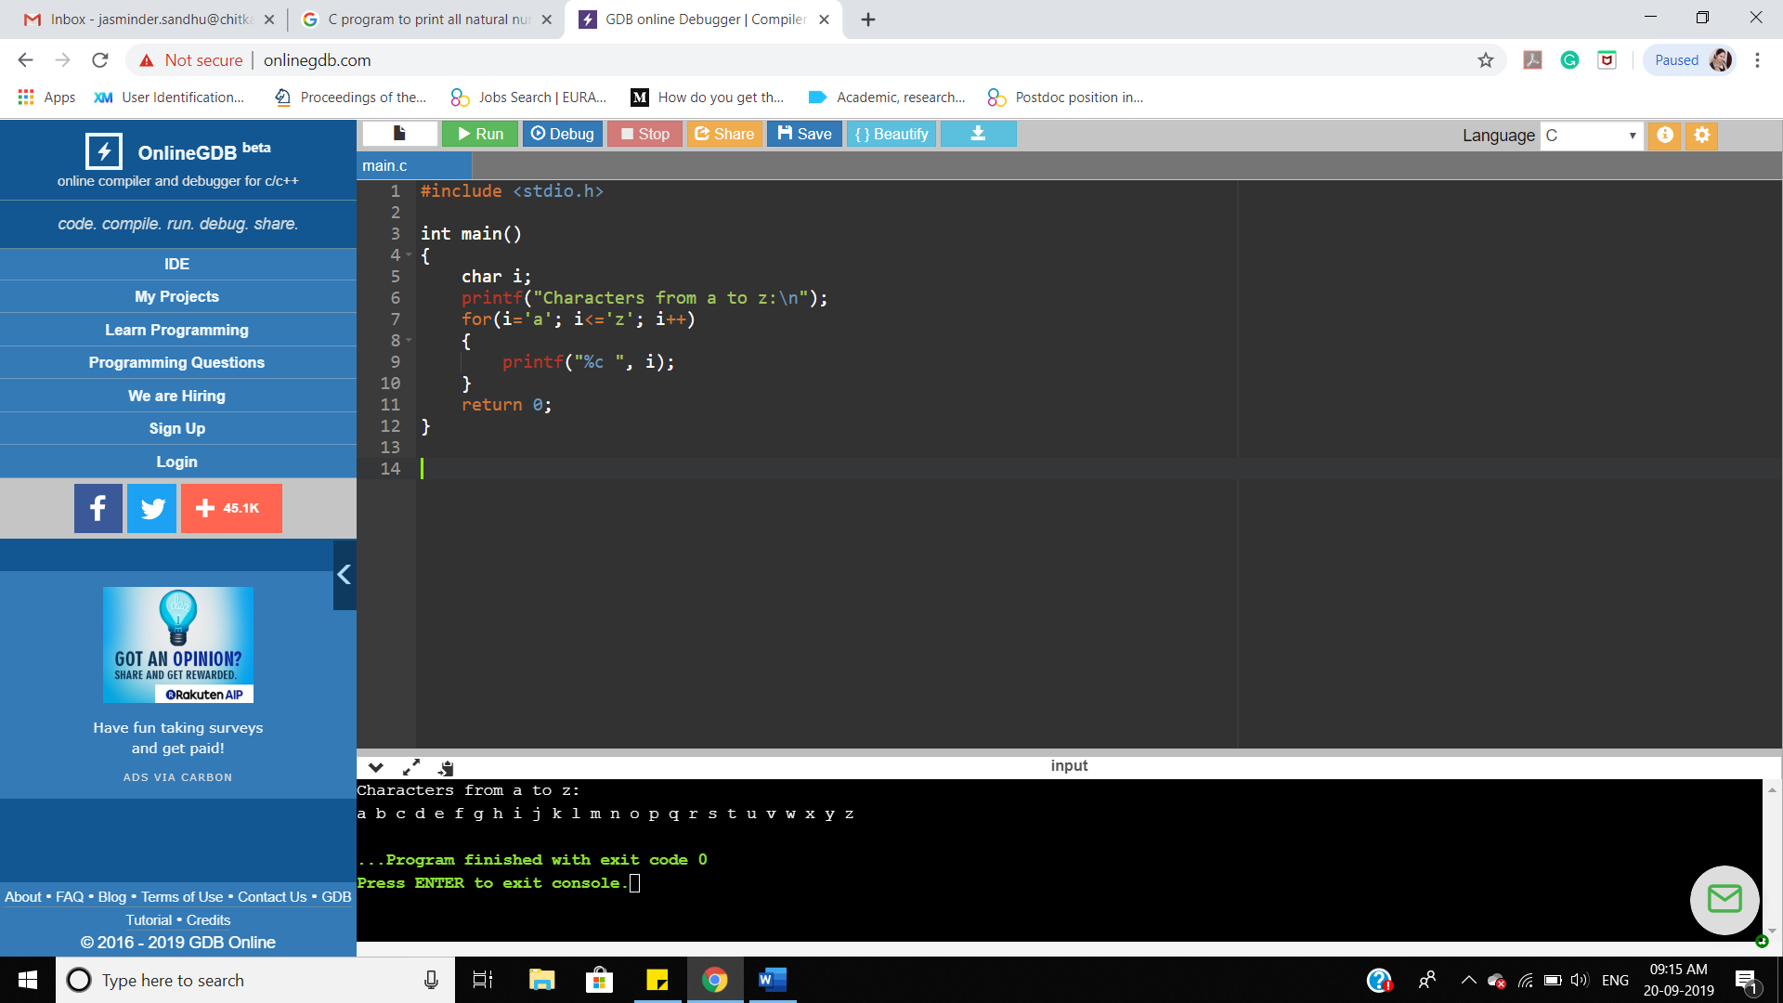
Write a C program to print all alphabets from a to z.

Slide 44
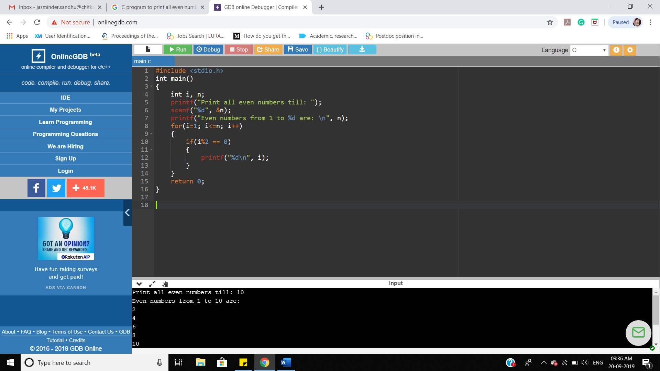
Write a C program to print all even numbers between 1 to 100

Slide 45
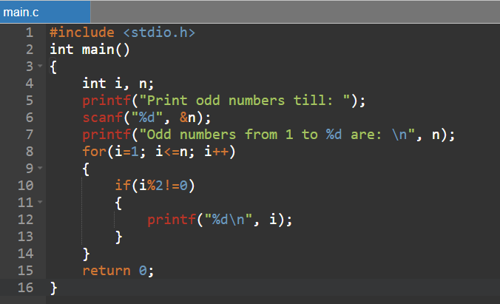
Write a C program to print all odd number between 1 to 100.

Slide 46
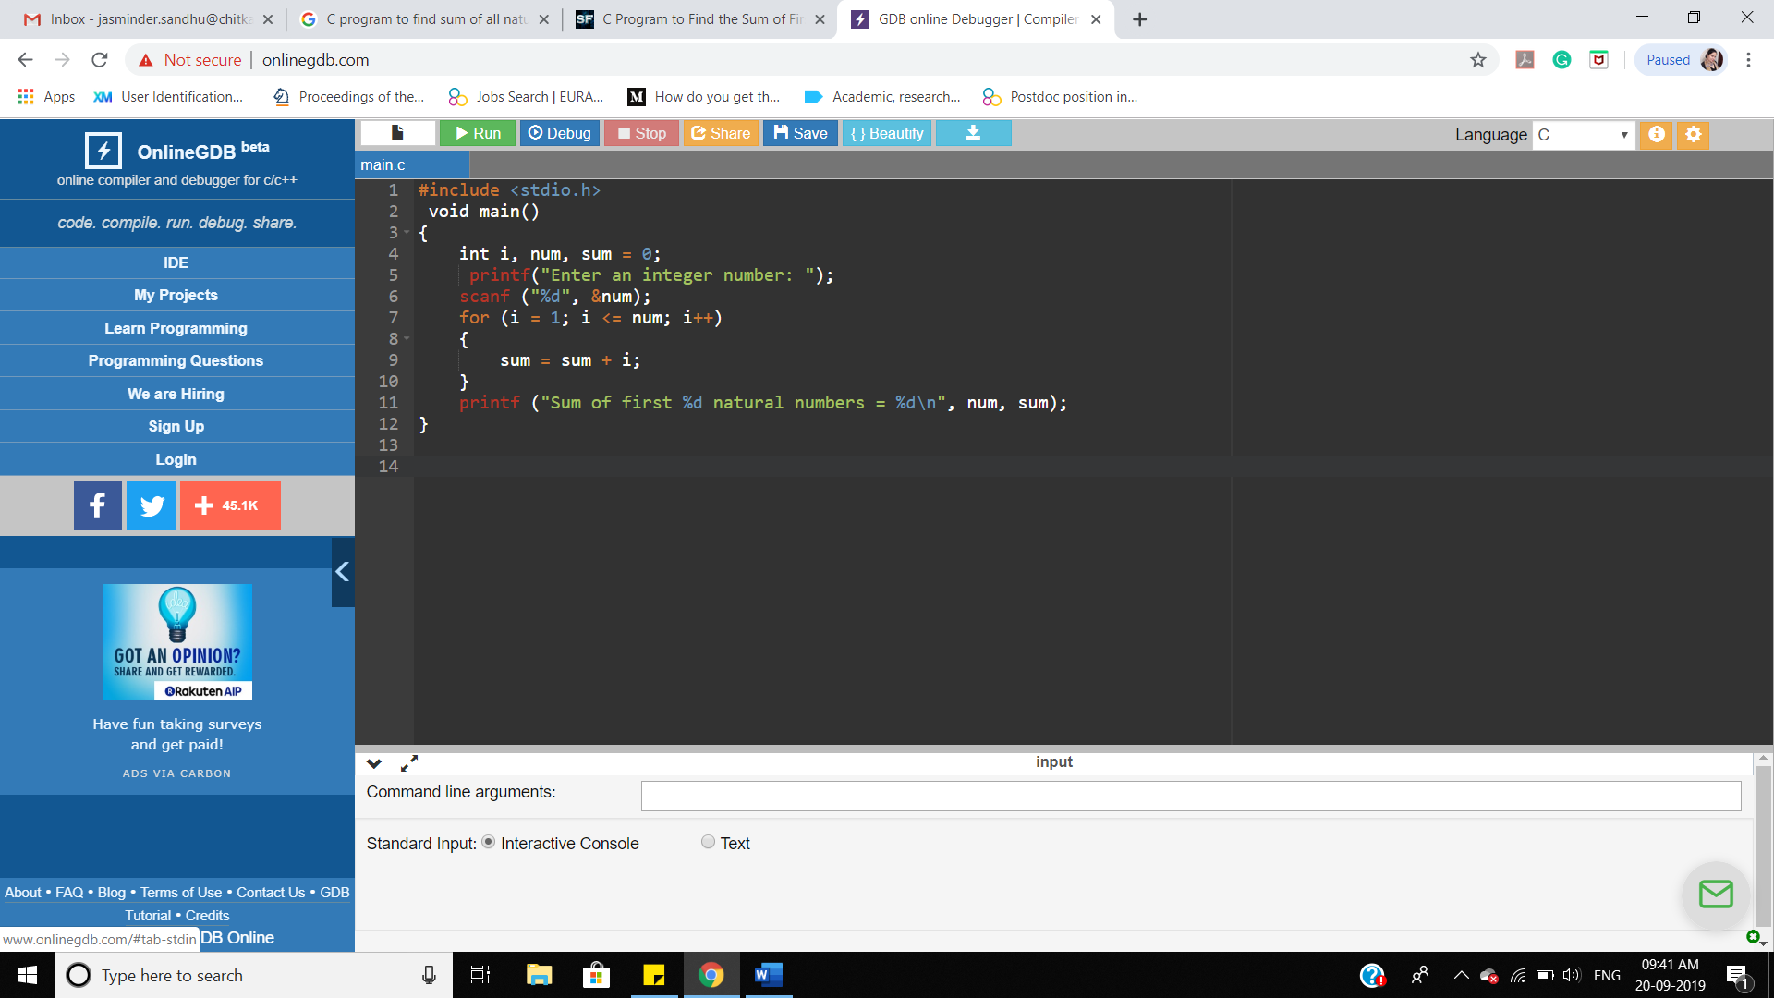
Write a C program to find sum of all natural numbers between 1 to n.

Slide 47
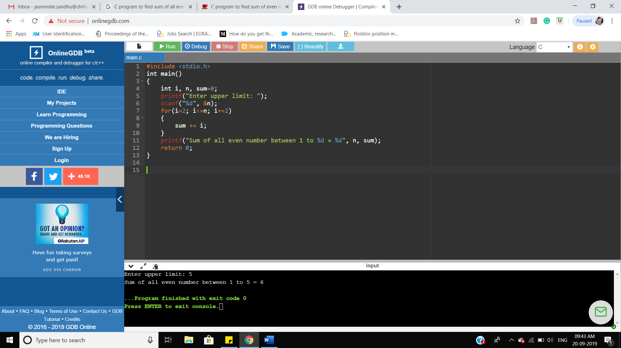
Write a C program to find sum of all even numbers between 1 to n.

Slide 48
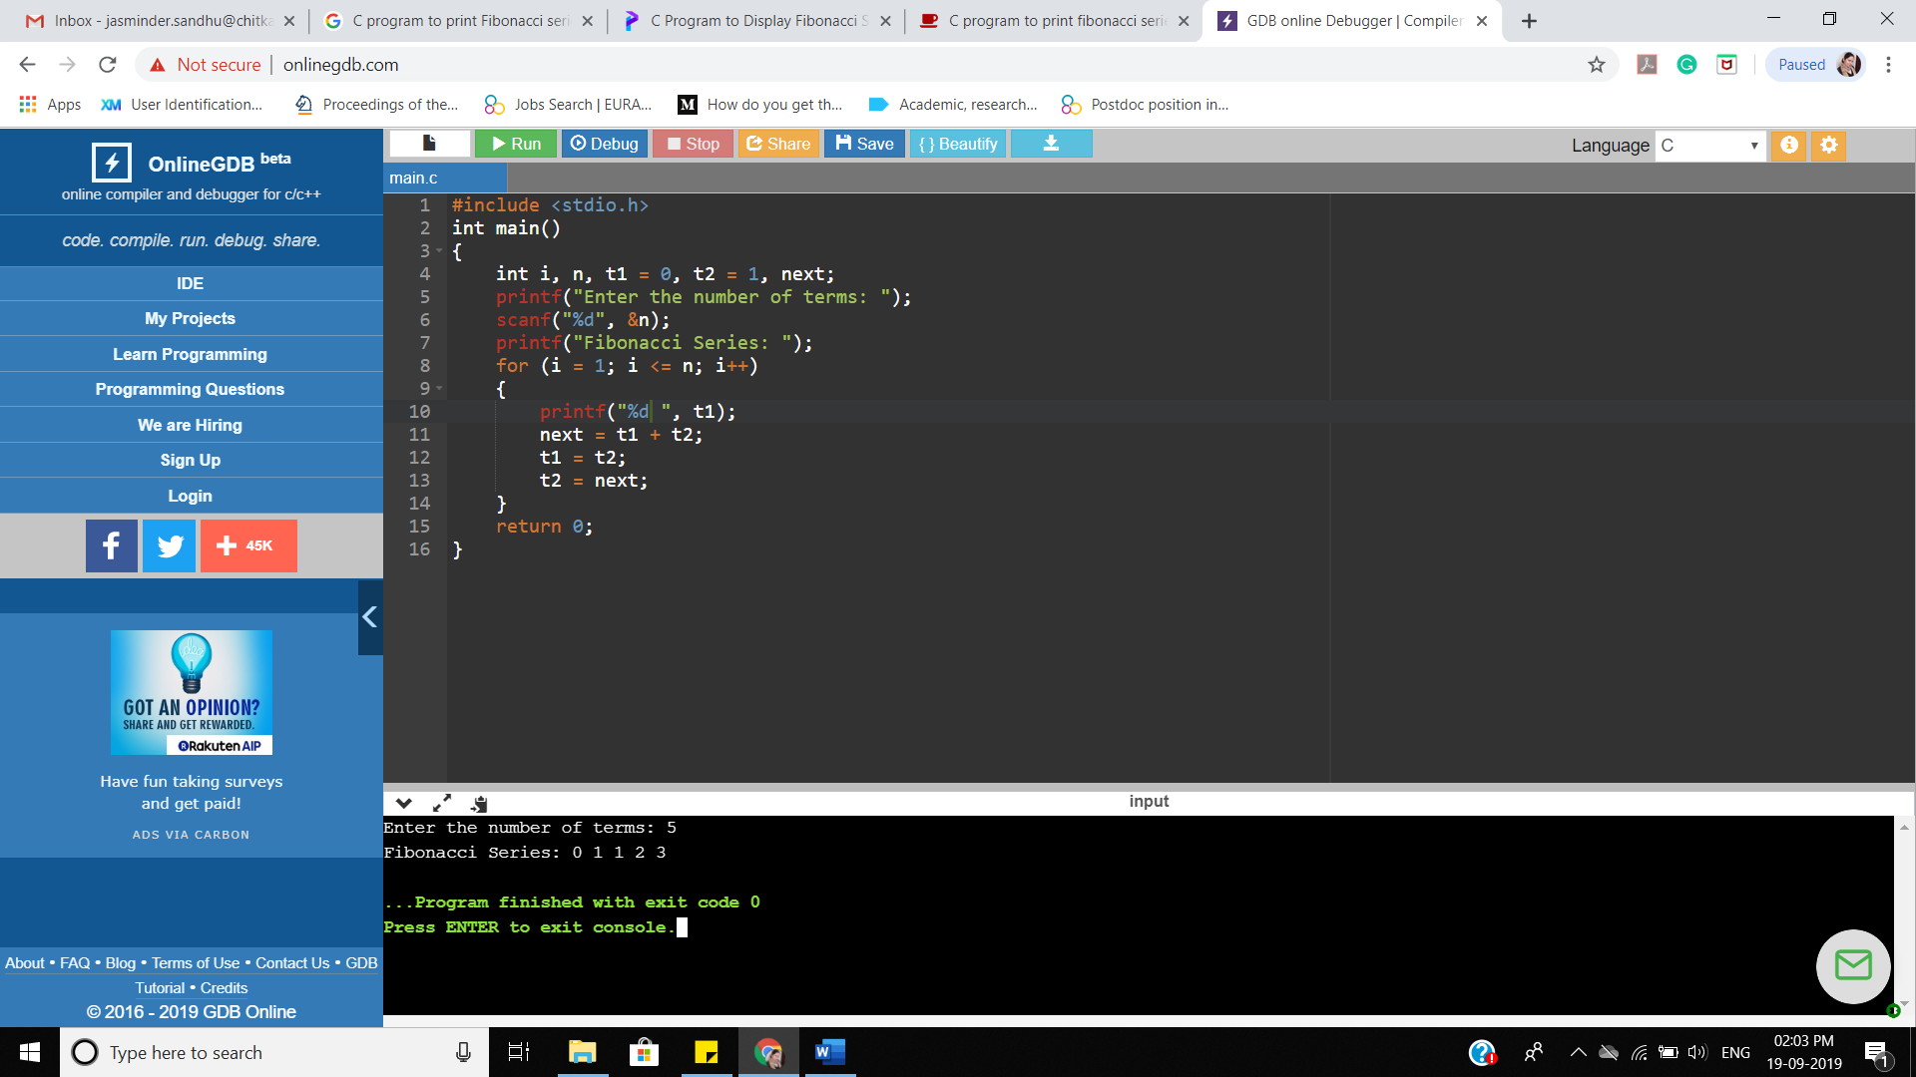
Write a C program to print Fibonacci series up to n terms.

Slide 49
program to print number in words

Slide 50
int main()
{ int n, num = 0;
/* Input number from user */
printf("Enter any number to print in words: ");
scanf("%d", &n);
/* Store reverse of n in num */
while(n != 0)
{ num = (num * 10) + (n % 10);
n /= 10;
}

Slide 51
/* * Extract last digit of number and print corresponding digit in words till num becomes 0 */
while(num != 0)
{ switch(num % 10)
{ case 0: printf("Zero "); break;
case 1: printf("One "); break;
case 2: printf("Two "); break;
case 3: printf("Three "); break;
case 4: printf("Four "); break;
case 5: printf("Five "); break;
case 6: printf("Six "); break;
case 7: printf("Seven "); break;
case 8: printf("Eight "); break;
case 9: printf("Nine "); break;
} num = num / 10;
}
return 0;}

Slide 52
int i;
for(i=1;i<=5;i++)
{
printf("%d\t,i);
}

Slide 53
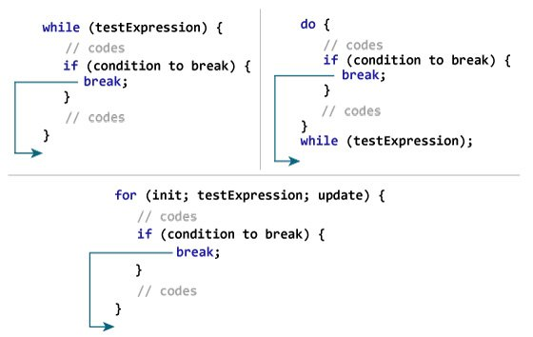
Break and Continue Statements – Loop Control Statements

Slide 54
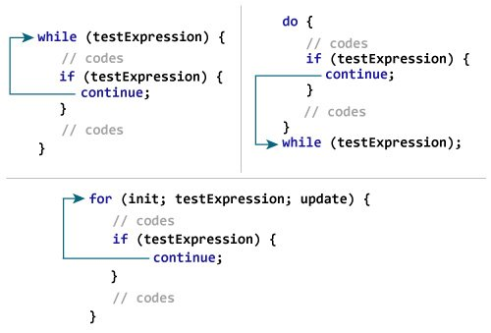
Continue Statement

Slide 55
#include <stdio.h>
int main()
{ int i=0;
while(i<=10)
{
if(i==5)
break;
printf("\n%d",i);
i++;
}
return 0;}
Notes:
Output
0
1
2
3
4

Slide 56
#include<stdio.h>
void main()
{ int i;
for(i=0;i<=10;i++)
{ if(i==5)
{ continue;
}
printf("%d\t",i);
}
}
Output : 0 1 2 3 4 6 7 8 9 10

Slide 57
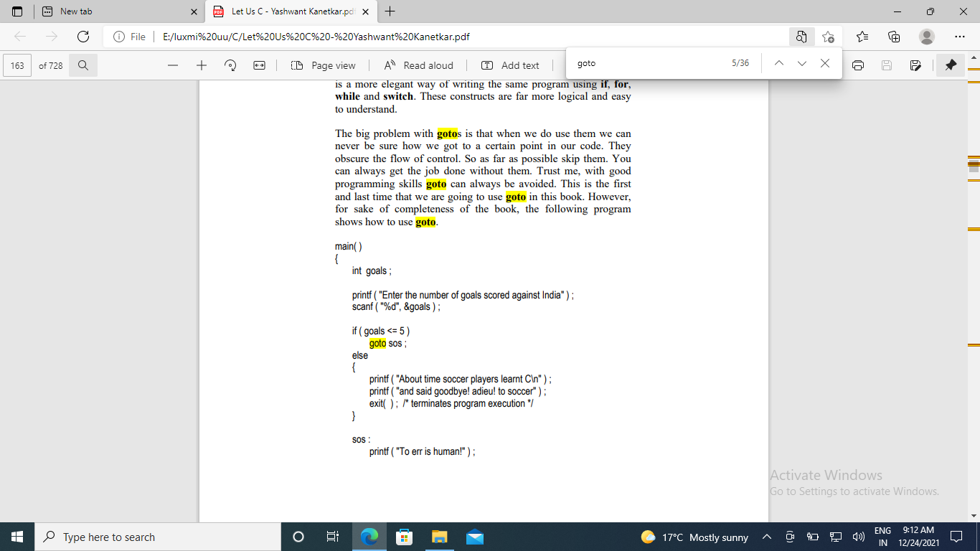
go to statement : The goto statement is used to transfer control to a specified label
.
The exit( ) function is a standard library function which terminates the execution of the program. It is necessary to use this function since we don't want the statement printf ( "To err is human!" ) to get executed after execution of the else block.

Slide 58
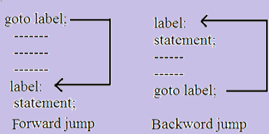

Slide 59
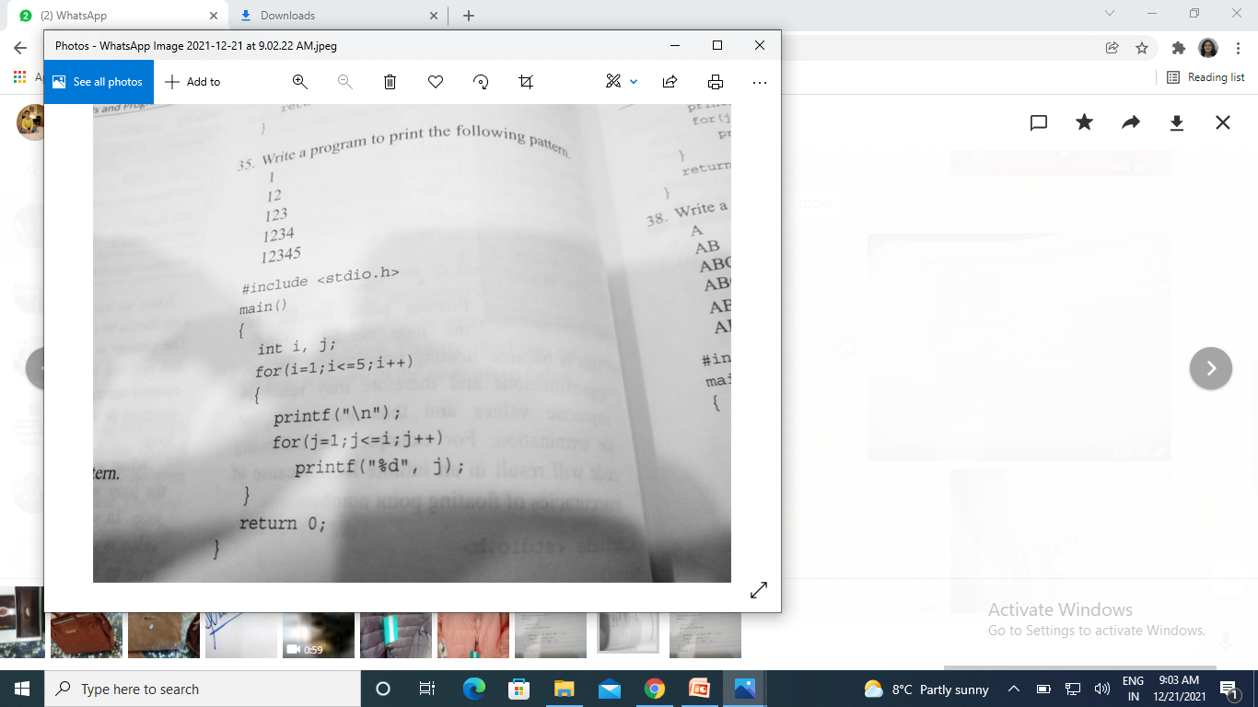

Slide 60
1 2 1 3 2 1 4 3 2 1 5 4 3 2 1
1. Draw the pattern

Slide 61
#include <stdio.h> int main() { int i,j; for(i=1;i<=5;i++) { for(j=i;j>=1; j--) {printf("%d ", j); } printf("\n"); } return 0; }
Notes:
1
2 1
3 2 1
4 3 2 1
5 4 3 2 1

Slide 62
1 2 3 4 5 1 2 3 4 1 2 3 1 2 1
Q2

Slide 63
int main() { int i,j; for(i=5;i>=1;i--) { for(j=1;j<=i; j++) {printf("%d ", j); } printf("\n"); } return 0;}
Notes:
1 2 3 4 5
1 2 3 4
1 2 3
1 2
1

Slide 64
5 4 3 2 1 5 4 3 2 5 4 3 5 4 5
Q3

Slide 65
int main() { int i,j; for(i=1;i<=5;i++) { for(j=5;j>=i; j--) {printf("%d ", j); } printf("\n"); } return 0; }
Notes:
5 4 3 2 1
5 4 3 2
5 4 3
5 4
5

Slide 66
5 5 4 5 4 3 5 4 3 2 5 4 3 2 1
Q4

Slide 67
#include <stdio.h> int main() { int i,j; for(i=5;i>=1;i--) { for(j=5;j>=i; j--) {printf("%d ", j); } printf("\n"); } return 0;}
Notes:
5
5 4
5 4 3
5 4 3 2
5 4 3 2 1

Slide 68
A B A C B A D C B A E D C B A
q5

Slide 69
int main() { int i,j; for(i=1;i<=5;i++) { for(j=i;j>=1; j--) { printf("%c ", j+64); } printf("\n"); } return 0;}
Notes:
A
B A
C B A
D C B A
E D C B A

Slide 70
A B C D E A B C D A B C A B A
Q6

Slide 71
#include <stdio.h> int main() { int i,j; for(i=5;i>=1;i--) { for(j=1;j<=i; j++) {printf("%c ", j+64); } printf("\n");} return 0;}
Notes:
A B C D E
A B C D
A B C
A B
A

Slide 72
* * * * * * * * * * * * * * * * * * * * *
Q7

Slide 73
#include <stdio.h> void main() { int i, j, rows; printf("Enter the number of rows: "); scanf("%d", &rows); for (i = 1; i <= rows; i++) { for (j = 1; j <= i; j++) { printf("* "); } printf("\n"); }
Notes:
Enter the number of rows: 6
*
* *
* * *
* * * *
* * * * *
* * * * * *

Slide 74
* * * * * * * * * * * * * * *
q8

Slide 75
#include <stdio.h> int main() { int i, j, rows; printf("Enter the number of rows: "); scanf("%d", &rows); for (i = rows; i >= 1; i--) { for (j = 1; j <= i; j++) { printf("* "); } printf("\n"); } return 0;}
Notes:
Enter the number of rows: 5
* * * * *
* * * *
* * *
* *
*

Slide 76
Enter the number of rows: 5 1 2 3 4 5 6 7 8 9 10 11 12 13 14 15
q9

Slide 77
{int n; printf("Enter the number of rows"); scanf("%d",&n); for(int i=1;i<=n;i++) { for(int j=1;j<=n;j++) { if(i==1 ||i==n||j==1||j==n) { printf("*"); } else printf(" "); } printf("\n"); } }
Notes:
*****
* *
* *
* *
*****

Slide 78
Enter the number of rows5 * * * * * * * * * * * *

Slide 79
int main() { int n,m=1; printf("Enter the number of rows"); scanf("%d",&n); for(int i=n;i>=1;i--) { for(int j=1;j<=i;j++) { if(j==1 || j==i || i==n) printf("*"); else printf(" "); } printf("\n"); }
Notes:
Enter the number of rows5
*****
* *
* *
**
*

Slide 80
#include <stdio.h> void main() { int rows, i, j, n = 1; printf("Enter the number of rows: "); scanf("%d", &rows); for (i = 1; i <= rows; i++) { for (j = 1; j <= i; j++) { printf("%d ", n); n++; } printf("\n"); } }
Notes:
Enter the number of rows: 5
1
2 3
4 5 6
7 8 9 10
11 12 13 14 15

Slide 81
#include <stdio.h>
int main()
{ int i, j;
char input, alphabet = 'A';
printf("Enter an uppercase character you want to print in the last row: ");
scanf("%c", &input);
for (i = 1; i <= (input - 'A' + 1); ++i)
{ for (j = 1; j <= i; ++j)
{ printf("%c ", alphabet);
} ++alphabet;
printf("\n");
}
return 0;}
Notes:
65 A-
69-E
Enter an uppercase character you want to print in the last row: E
A
B B
C C C
D D D D
E E E E E

Slide 82
add integers until user enters 0

Slide 83
#include <stdio.h> int main() {int num, sum = 0; do {printf("Enter a number: "); scanf("%d", &num); sum =sum+ num;} while(num != 0); printf("Total = %d",sum); return 0;}

Slide 84
#include<stdio.h> #include<stdlib.h> void main () { char c; int choice,dummy; do{ printf("\n1. R programming. Print c programming 3. Exit\n"); scanf("%d",&choice); switch(choice) { case 1 : printf(“R programming"); break; case 2: printf(“c programming"); break; case 3: exit(0); break; default: printf("please enter valid choice"); } printf("do you want to enter more?"); scanf("%d",&dummy); scanf("%c",&c); }while(c=='y'); }

Slide 85
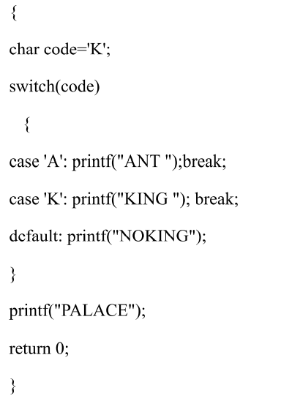

Slide 86
int main()
{ int a=1 , b=3; a += b -= a-=b; printf("%d %d",a,b); }
Notes:
a=a+b=b=b-a=a=a-b; execute from right to left. 3= -2+5= 5 = 3 - (-2) = -2 = 1-3
Output a=3 b=5

Slide 87
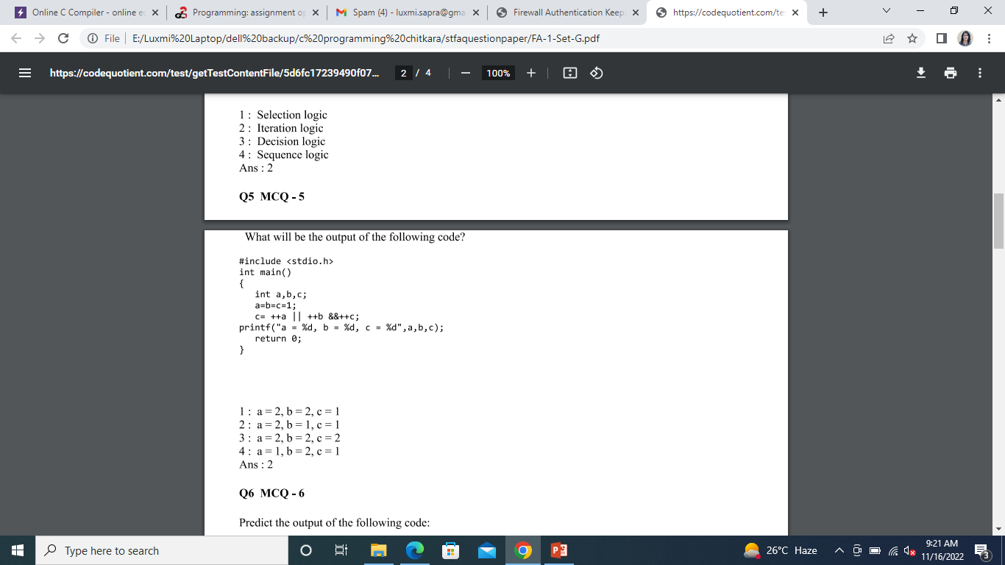
Notes:
Ans 2

Slide 88
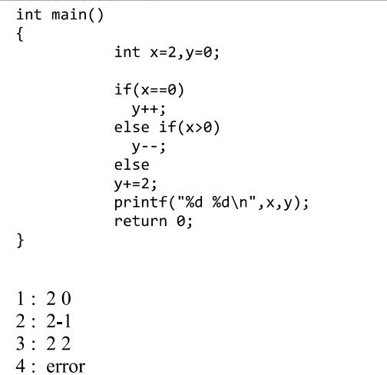
Notes:
Ans 2

Slide 89
#include <stdio.h> int main() { int k=10; if (k++==10) {printf("%d",k); } printf("%d",k); return 0;}
Notes:
11
11

Slide 90
int main() { int x,y,z,k=10; k+=(x=5,y=x+2,z=x+x); printf("value of x=%d, value of y is =%d, value of z= is %d, value of k is %d",x,y,z,k); return 0; }
Notes:
value of x=5,
value of y is =7,
value of z= is 10,
value of k is 20
Bracket left to right

Slide 91
{ int i;
for(i=0;i<20;i++)
{ switch(i)
{ case 0: i+=5;
printf("\nvalue of i in case 0 is %d",i);
case 1:
i-=2;
printf("\nvalue of i in case 1 is %d",i);
case 5:
i+=6;
printf("\nvalue of i in case 5 is %d",i);
default:
i+=4;
printf("\nvalue of i in case defaul is %d",i);
}
} printf("\n value of i after the completion of loop is%d",i);
Notes:
value of i in case 0 is 5 (no break is there)
value of i in case 1 is 3
value of i in case 5 is 9
value of i in case defaul is 13
value of i in case defaul is 18
value of i in case defaul is 23
value of i after the completion of loop is24

Slide 92
int main()
{
int a=5,b=3;
switch(a+=b-=a+=b)
{ case 1: printf("one");
break;
case 2:
printf("two");
break;
case 3:
printf("three");
break;
case 4:
printf("four");
break;
default:
printf("default");
break; }
return 0;}
Notes:
Output
Three
3= -2+5= 5 = 3 - (-2) = -2 = 1-3

Slide 93
int main()
{ int a=1, b;
for(;a<2;a++)
{ b=printf("value of a is %d",a);
}
printf("value of b is %d",b);
if(b==2)
printf("b is 2");
else if(b==1)
printf("b is 1");
else
printf("b is neither 0 nor 1");
return 0;
}
Notes:
Output
value of a is 1
value of b is 15
b is neither 0 nor 1

Slide 94
#include <stdio.h> int main() { int n=0,i; for(i=10;i;n+=i,i--) { printf("value of n is %d\n",n); printf("value of i is %d\t", i); } return 0;}
Notes:
value of n is 0
value of i is 10 value of n is 10
value of i is 9 value of n is 19
value of i is 8 value of n is 27
value of i is 7 value of n is 34
value of i is 6 value of n is 40
value of i is 5 value of n is 45
value of i is 4 value of n is 49
value of i is 3 value of n is 52
value of i is 2 value of n is 54
value of i is 1

Slide 95
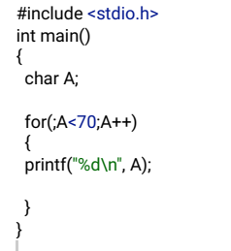
Notes:
Output : it will print 0 to 69
char A='A'; (then it will print 69 to 70

Slide 96
#include <stdio.h> int main() { int a=8+9-12; do { printf("%d",a); a++; } while(0); printf(“final value of a is %d",a); return 0;}
Notes:
Output
5
Final value of a is 6
value 0 have meaning called FALSE(0x00000000). so whenever a loop receives a FALSE input it will just leave the loop and proceeds with the next immediate statement.

Slide 97
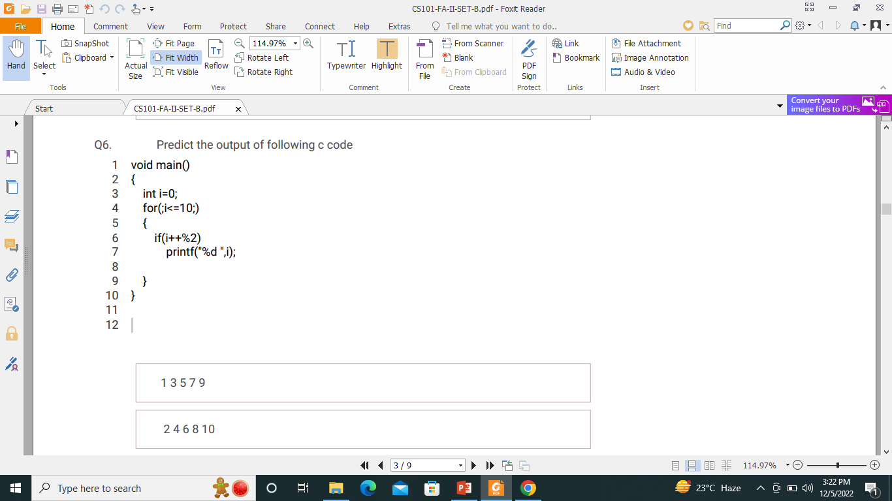
Notes:
Output
2
4
6
8
10

Slide 98
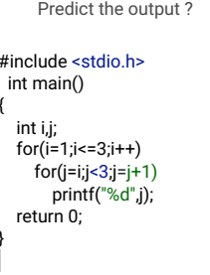
Notes:
Output 122

Slide 99
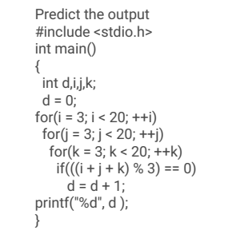
Notes:
Output 1637

Slide 100
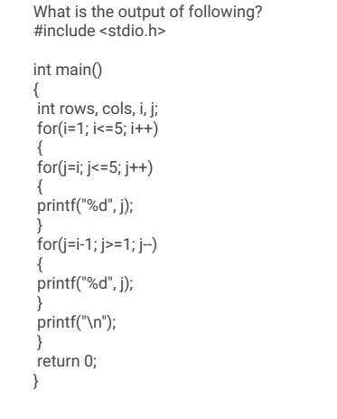
Notes:
Output
12345
23451
34521
45321
54321

Slide 101
#include <stdio.h> int main() { int x=0; while(x<3) x++; printf(“hello %d",x); return 0;}
Notes:
Output
Hello 3
No bracket in while loop

Slide 102
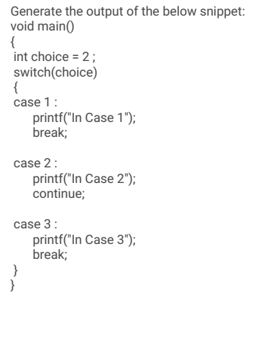
Notes:
Output : error

Slide 103
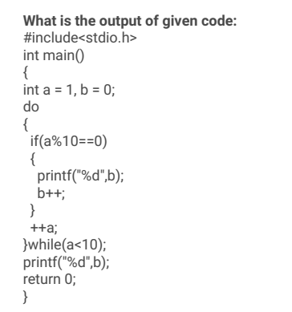
Notes:
Output : 0

Slide 104
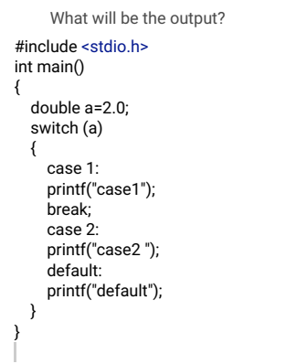
Notes:
Output : error

Slide 105
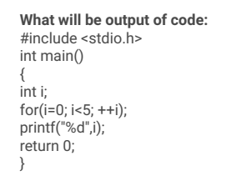
Notes:
Output 5

Slide 106
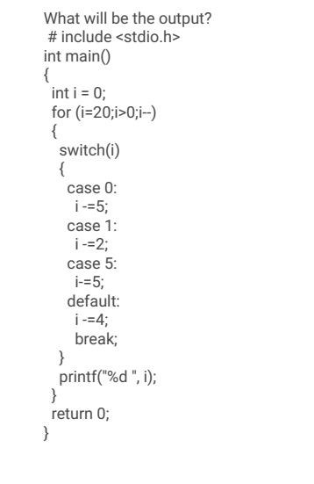
Notes:
Output : 16 11 6 -4

Slide 107
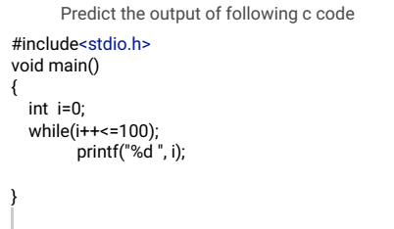
Notes:
Output 101

Slide 108
#include <stdio.h> int main() { while(!!NULL); printf("MCA"); return 0;}
#include <stdio.h>
int main(){ while(!!NULL) printf("MCA"); return 0;}
Notes:
NULL is macro (!null =1; !1 =0)
MCA
2. Nothing will be printed

Slide 109
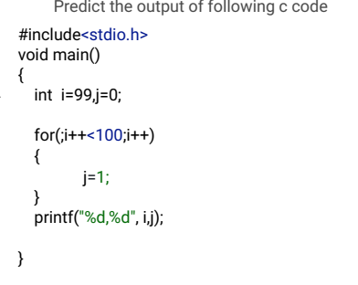
Notes:
Output 102, 1

Slide 110
include <stdio.h> int main() { int k=-1; do{ printf("programming"); } while(k++); return 0;}
Notes:
K++ is post increment (-1,1,0)
Programming will be printed 2 times

Slide 111
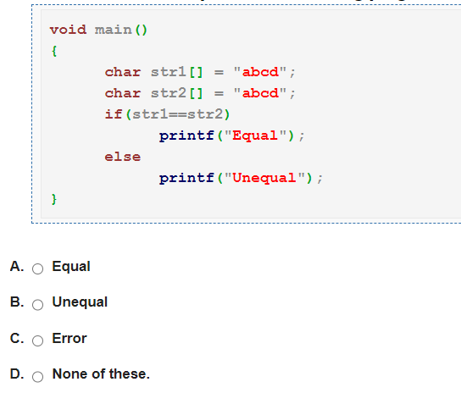
Notes:
Answer: Option B
Solution:
Strings are compared using strcmp() function defined under string.h header file.

Slide 112
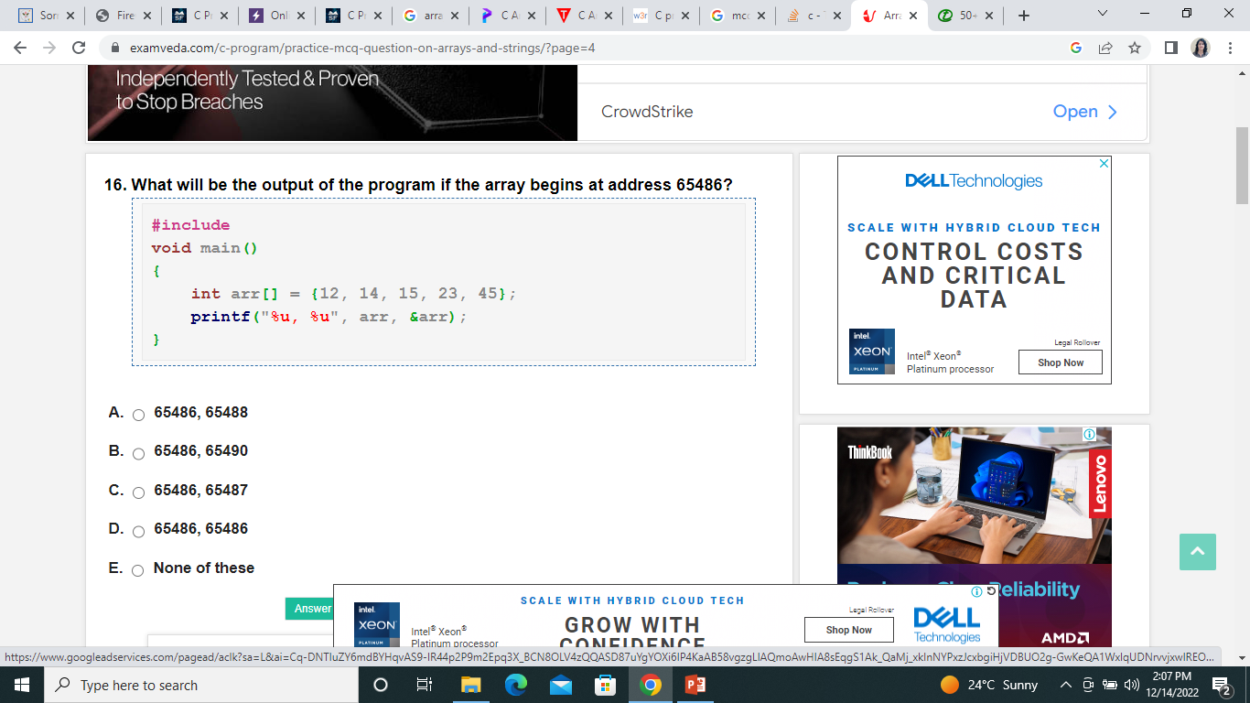
Notes:
Ans 65486, 65486

Slide 113
int main() { char grade[] = {'A','B','C'}; printf("GRADE=%c, ", *grade); printf("GRADE=%d", grade); }
Notes:
Output GRADE A and base address of array

Slide 114
#include <stdio.h> int main() { int i = 0; printf("Hello"); char s[4] = {'\b', '\t', '\r', '\n'}; for(i = 0;i<4;i++) { printf("%c", s[i]); } return 0;}
Notes:
Output : Hello
Printf(“%c”, s[i]); nothing will be printed
\b Backspace
\r Carriage Return

Slide 115
int main() { int st[4] = {10, 20, 30, 40}; printf("%d\n", *st); return 0; }
Notes:
Output 10

Slide 116
UNIT-4

Slide 117
Arrays
The variables that we have used till now are capable of storing only one value at a time. Consider a situation when we want to store and display the age of 100 employees.
For this we have to do the following
1.· Declare 100 different variables to store the age of employees.
2. Assign a value to each variable.
3. Display the value of each variable.
An array is a collection of similar type of data items and each data item is called an element of the array. The data type of the elements may be any valid data type like char, int or float. The elements of array share the same variable name but each element has a different index number known as subscript.

Slide 118
For the above problem we can take an array variable age[ 100] of type into The size of this array variable is 100 so it is capable of storing 100 integer values.
The individual elements of this array are- age[0], age[l], age[2], age[3], age[4], age[98],…. age[99]
Arrays can be single dimensional or multidimensional. The number of subscripts determines the dimensions of array.
A one-dimensional array has one subscript, two dimensional array has two subscripts and on.
The one-dimensional arrays are known as vectors and two-dimensional arrays are known as matrices

Slide 119
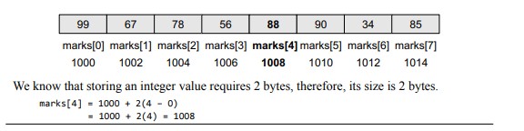
Calculating the Address of Array Elements
array name is a symbolic reference to the address of the first byte of the array. When we use the array name, we are actually referring to the first byte of the array. Since an array stores all its data elements in consecutive memory locations, storing just the base address, that is the address of the first element in the array, is sufficient. The address of other data elements can simply be calculated using the base address. The formula to perform this calculation is
Address of data element, A[k] = BA(A) + w(k – lower_bound)
Here, A is the array, k is the index of the element of which we have to calculate the address, BA is the base address of the array A, and w is the size of one element in memory, for example, size of int is 2
Given an array int marks[]={99,67,78,56,88,90,34,85}, calculate the address of marks[4] if the base address = 1000.

Slide 120
One Dimensional Array
Declaration of I-D Array
data_type array_name[size];
int age[100];
float sal[15];
char grade[20];
When the array is declared, the compiler allocates space in .memory sufficient to hold all the elements of the array, so the compiler should know the size of array at the compile time
Accessing I-D Array Element
The elements of an array can be accessed by specifying the array name followed by subscript in brackets.

Slide 121
Int arr[10] is an array of int type-
(i) Reading values in arr[10]
Fore( i = 0; i < 10; i++)
scanf("%d", &arr[i]);
(ii) Displaying values of arr[ 10]
fore( i = 0; i < 10; i++)
printf(%d ", arr[i])
(iii) Adding all the elements of arr[ 10]
sum = 0;
for (i = 0; i < 10; i++)
sum=sum+arr[i];

Slide 122
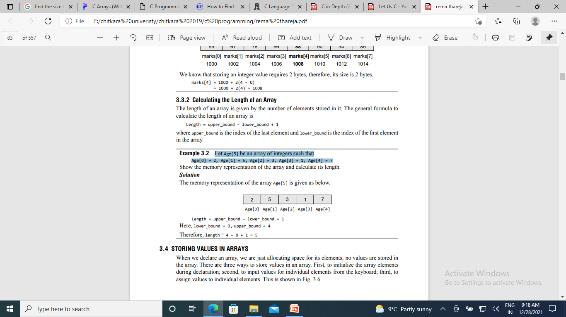
Calculating the Length of an Array
The length of an array is given by the number of elements stored in it. The general formula to calculate the length of an array is
Length = upper_bound – lower_bound + 1
where upper_bound is the index of the last element and lower_bound is the index of the first element in the array
Let Age[5] be an array of integers such that Age[0] = 2, Age[1] = 5, Age[2] = 3, Age[3] = 1, Age[4] = 7

Slide 123
OPERATIONS ON ARRAY
Traversing an array : Traversing an array means accessing each and every element of the array for a specific purpose.
Inserting an element in an array
Searching an element in an array
Deleting an element from an array
Merging two arrays
Sorting an array in ascending or descending order

Slide 124
find the average of n numbers using arrays
{ int marks[10], i, n, sum = 0, average;
printf("Enter number of elements: ");
scanf("%d", &n);
for(i=0; i<n; i++)
{ printf("Enter number%d: ",i+1);
scanf("%d", &marks[i]
sum = sum+marks[i]; }
average = sum/n;
printf("Average = %d", average);

Slide 125
search for an item in the array
void main()
{ int num, i, item, found = 0, array[num];
printf("Enter the number of elements ");
scanf("%d", &num);
printf("Enter the elements of array \n");
for (i = 0; i < num; i++)
{ scanf("%d", &array[i]); }
printf("Enter the element to be searched ");
scanf("%d", &item);
for (i = 0; i < num ; i++)
{ if (item == array[i] )
{
found = 1;
break; } }
if (found == 1)
printf("Element is present in the array at position %d",i+1);
else
printf("Element is not present in the array\n");
}

Slide 126
Binary Search
int c, first, last, middle, n, search, array[50];
printf("Enter number of elements\n"); scanf("%d", &n);
printf("Enter %d integers\n", n);
for (c = 0; c < n; c++) scanf("%d", &array[c]);
printf("Enter value to find\n"); scanf("%d", &search);
first = 0; last = n - 1; middle = (first+last)/2;
while (first <= last) { if (array[middle] < search) first = middle + 1; else if (array[middle] == search) { printf("%d found at location %d.\n", search, middle+1); break; } else last = middle - 1;
middle = (first + last)/2; } if (first > last) printf("Not found! %d isn't present in the list.\n", search);

Slide 127
WAP to accept username and pw from a user. After 4th attempt print access denied. If the id and password matches print “successful logged” otherwise print “wrong password and try again”

Slide 128
int main()
{ char ID[]="programming“;
char password[]="123@gehu", id[20], p[20];
int s=1, a, b;
do{
printf("\nEnter ID:");
scanf("%s", id);
fflush(stdout);
printf("\nEnter Password:");
scanf("%s", p);
fflush(stdout);
a=strcmp(id, ID);
b=strcmp(p, password);

Slide 129
if(a==0 && b==0)
{ printf("\nSucessfully Logged In");
break; }
else
{ printf("\nWrong Password, try again"); }
s++;
if(s>4)
{ printf("\nAccess Denied"); }
} // closing of do
while (s<=4);
} // closing of while

Slide 130
Initialization of I-D Array
int marks[5] = {50, 85, 70, 65, 95}
While initializing I-D arrays, It is optional to specify the size of the array. If the size is omitted during initialization then the compiler assumes the size of array equal to the number of initializers
. For example-
int marks[] = { 99, 78, 50,45, 67, 89};
float sal[] = { 25.5, 38.5, 24.7};
here the size of array marks is assumed to be 6 and that of sal is assumed to be 3
If during initialization the number of initializers is less than the size of array then, all the remaining elements of array are assigned value zero.
For example- int marks[5] = { 99, 78};
Here the size of array is 5 while there are only 2 initializers. After this initialization the value of the elements are as-
marks[0] : 99, marks[l]: 78, marks[2]: 0, marks[3]: 0, marks[4]: 0

Slide 131
int arr[I0] = {0};
then all the elements of arr will be initialized to zero

Slide 132
Write a C program to count the positive negative and zeros in given array.
#include<stdio.h>
int main() {
int a[100], n, i, positive=0, negative=0, zero=0;
printf("Enter array size [1-100]: ");
scanf("%d", &n);
printf("Enter %d elements: ",n);
for(i=0; i<n; i++)
{ scanf("%d", &a[i]);
if(a[i]>0)
positive++;
else if(a[i]==0)
zero++;
else
negative++; }

Slide 133
Find Smallest and Largest Number with their Position in Array using C
#include<stdio.h>
int main()
{ int a[100], n, i, max, min, maxPos, minPos;
("Enter array size [1-100]: ");
scanf("%d",&n);
maxPos=minPos=0; //Take array elements and find min and max printf("Enter array elements: ");
scanf("%d",&a[0]);
max=min=a[0];
for(i=1; i<n; i++)
{ scanf("%d",&a[i]);
if(max<a[i])
{ min=a[i];
minPos=i; }
if(min>a[i])
{ min=a[i];
minPos=i; } }

Slide 134
printf("Positive number count is %d", positive); printf("\nNegative number count is %d", negative); printf("\nZeros count is %d", zero);
return 0;
}

Slide 135
2D Array
A two-dimensional array is an array of arrays that has two values 1) number of rows and 2) number of columns in each row. It can be considered as a matrix with rows and columns.
syntax to declare a two-dimensional array in C
type array_name[rows] [columns];
Initialization of 2D Array
int disp[2][4] = { {10, 11, 12, 13},
{14, 15, 16, 17} };
int disp[2][4] = { 10, 11, 12, 13, 14, 15, 16, 17};
// Different ways to initialize two-dimensional array
int c[2][3] = {{1, 3, 0}, {-1, 5, 9}};
int c[][3] = {{1, 3, 0}, {-1, 5, 9}};
int c[2][3] = {1, 3, 0, -1, 5, 9};

Slide 136
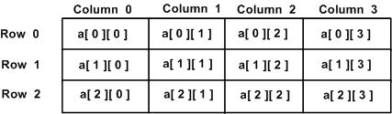

Slide 137
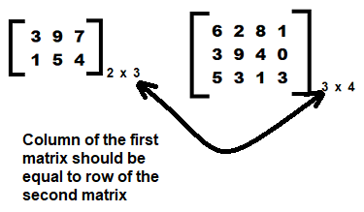
Matrix Multiplication
Two matrices can be multiplied only and only if number of columns in the first matrix is same as number of rows in second matrix.

Slide 138
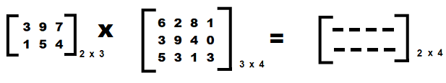
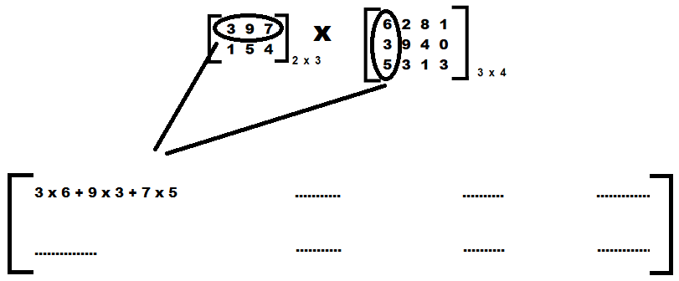
The resultant matrix will be of the order 2 x 4, that is, the resultant matrix will have the same number of rows as the first matrix and the same number of columns as the second matrix:

Slide 139
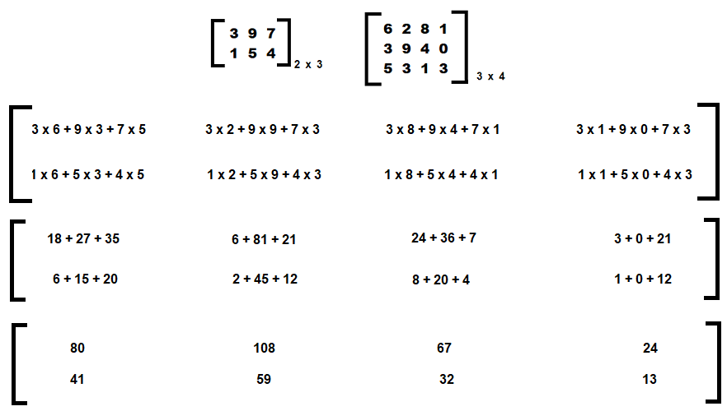

Slide 140
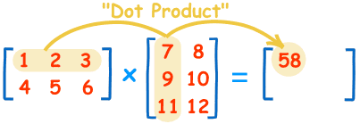
(1, 2, 3) • (7, 9, 11) = 1×7 + 2×9 + 3×11 = 58
(1, 2, 3) • (8, 10, 12) = 1×8 + 2×10 + 3×12 = 64
(4, 5, 6) • (7, 9, 11) = 4×7 + 5×9 + 6×11 = 139
(4, 5, 6) • (8, 10, 12) = 4×8 + 5×10 + 6×12 = 154
To multiply a matrix by another matrix we need to do the “dot product” of rows and columns

Slide 141
int a[5][5],b[5][5],c[5][5],i,j,k,r1,c1,r2,c2;
printf("\n Enter the row and column of matrix 1 :");
scanf("%d %d",&r1,&c1);
printf("\n Enter the row and column of matrix 2 :");
scanf("%d %d",&r2,&c2);
if(c1!=r2)
{
printf("\n Matrix mutiplication is not possible");
printf("\n\n Column of 'matrix 1' must be same as row of 'matrix 2'");
}
else

Slide 142
{
printf("\n Enter the matrix 1 :\n\n");
for(i=0;i<r1;i++)
{
for(j=0;j<c1;j++)
{
scanf("%d",&a[i][j]);
}
}
printf("\n Enter the matrix 2 :\n\n");
for(i=0;i<r2;i++)
{
for(j=0;j<c2;j++)
{
scanf("%d",&b[i][j]);
}
}

Slide 143
for(i=0;i<r1;i++)
{
for(j=0;j<c2;j++)
{
c[i][j]=0;
for(k=0;k<c1;k++)
{
c[i][j]=c[i][j]+a[i][k]*b[k][j];
} } }
printf("\n The product matrix is :\n\n");
for(i=0;i<r1;i++)
{
for(j=0;j<c2;j++)
{
printf(" %d ",c[i][j]);
}
printf("\n");
} }
getch(); }

Slide 144
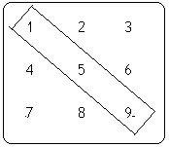
add a[0][0],a[1][1],a[2][2]]
when i = j Condition is true then and then only we have to add the elements
Addition of Diagonal Elements in Matrix
for (i = 0; i < row; i++) {
for (j = 0; j < col; j++) {
if (i == j)
sum = sum + mat[i][j];
printf("\nSum of Diagonal Elements in Matrix : %d", sum);

Slide 145
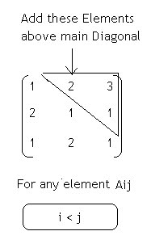
Clculate sum of Upper Triangular Elements in C
//Addition of all Diagonal Elements
sum = 0;
for (i = 0; i < rows; i++)
for (j = 0; j < columns; j++) {
// Condition for Upper Triangle
if (i < j) {
sum = sum + a[i][j];
}
}
printf("\nSum of Upper Triangle Elements : %d", sum);

Slide 146
i
int i, j, a[10][10], sum, rows, columns;
printf("\nEnter the number of Rows : ");
scanf("%d", &rows);
printf("\nEnter the number of Columns : ");
scanf("%d", &columns);
//Accept the Elements in Matrix
for (i = 0; i < rows; i++)
for (j = 0; j < columns; j++) {
printf("\nEnter the Element a[%d][%d] : ", i, j);
scanf("%d", &a[i][j]);
}
//Addition of all Diagonal Elements
sum = 0;
for (i = 0; i < rows; i++)
for (j = 0; j < columns; j++) {
// Condition for Upper Triangle
if (i < j) {
sum = sum + a[i][j];
}
}

Slide 147
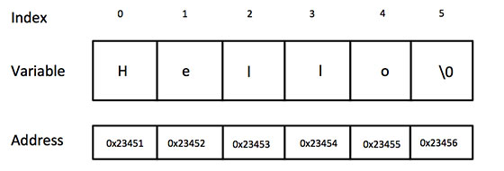
Strings in C
Strings are defined as an array of characters. Strings are one-dimensional array of characters terminated by a null character '\0'
Null character (‘\0’) used to indicate the termination of string
I

Slide 148
Initialize string
char c[] = “Hello";
char c[] = "abcd";
char c[50] = "abcd";
char c[] = {'a', 'b', 'c', 'd', '\0'};
char c[5] = {'a', 'b', 'c', 'd', '\0'};

Slide 149
scanf() to read a string
#include <stdio.h>
void main()
{ char name[20];
printf("Enter name: ");
scanf("%s", name); Aditi
printf("Your name is %s.", name); }
char str[ ]="India“ ;
for(int i=0; str[i] !='\0‘; i++)
{
printf (" %c” , str [i] );
}
void main( )
{ char name[ ] = “Algorithmic" ;
int i = 0 ;
while ( name[i] != `\0' )
{ printf ( "%c", name[i] ) ;
i++ ; }
}

Slide 150
scanf( ) is not capable of receiving multi-word strings. Therefore names such as ‘Algorithmic Thinking’ would be unacceptable.
The gets() allows the user to enter the space-separated strings
char name[20];
printf("Enter name, ");
gets (name) ;
printf (“entered name is. ") ;
puts (name) ;

Slide 151
C String Length:
strlen() function
The strlen() function returns the length of the given string. It doesn't count null character '\0'.
#include<stdio.h>
#include <string.h>
int main(){
char ch[20]={a', ‘l', ‘g', ‘o', 't', ‘r', ‘i', ‘t', ‘h', ‘m', '\0'};
printf("Length of string is: %d",strlen(ch));
return 0;
}

Slide 152
strcpy()
#include <stdio.h>
#include <string.h>
void main()
{ char str1[20] = "C programming";
char str2[20];
strcpy(str2, str1); // copying str1 to str2
puts(str2);
}

Slide 153
strcat()
the strcat() function contcatenates (joins) two strings.
#include <stdio.h>
#include <string.h>
void main()
{ char str1[50] = “Algorithmic Thinking“;
Char str2[] = “Programming in c ";
// concatenates str1 and str2 // the resultant string is stored in str1.
strcat(str1, str2);
puts(str1);
puts(str2);
}
Output :
Algorithm Thinking Programming in C
Programming in c

Slide 154
Print the length of the string length without using strlen function
void main()
{
char string[50];
int i, length = 0;
printf("Enter a string \n");
gets(string);
for (i = 0; string[i] != '\0'; i++)
{
length++;
}
printf("The length of a string is the number of characters in it \n");
printf("So, the length of %s = %d\n", string, length);
}

Slide 155
Write a program to find the length of a string.
int main()
{ char str[100];
Int i = 0, length;
clrscr();
printf("\n Enter the string : ");
gets(str)
while(str[i] != '\0')
i++;
length = i;
printf("\n The length of the string is : %d", length);
getch()
return 0; }

Slide 156
Write a program to append a string to another string.
int main()
{ char Dest_Str[100];
Char Source_Str[50];
int i=0, j=0; clrscr();
printf("\n Enter the source string : ");
gets(Source_Str);
printf("\n Enter the destination string : ");
gets(Dest_Str);
while(Dest_Str[i] != '\0')
{ i++; }
while(Source_Str[j] != '\0')
{ Dest_Str[i] = Source_Str[j];
i++;
j++; }
Dest_Str[i] = '\0';
printf("\n After appending, the destination string is : ");
puts(Dest_Str); getch(); return 0;
}

Slide 157
The strcmp() compares two strings character by character. If the strings are equal, the function returns 0.
Return Value from strcmp()
0 if strings are equal
>0 if the first non-matching character in str1 is greater (in ASCII) than that of str2.
<0 if the first non-matching character in str1 is lower (in ASCII) than that of str2.

Slide 158
#include <stdio.h>
#include<strings.h>
int main()
{ char str1[]="abcd",str2[]="abCd", str3[]="abcd";
int result1,result2;
result1= strcmp(str1, str2);
printf("%d", result1) ; 32
result2 = strcmp(str1, str3); printf("%d", result2); 0
return 0;}

Slide 159
Functions
Function is..a self-contained subprogram that is meant to do some specific, well-defined task. A ( program consists of one or more functions. If a program has only one function then it must be the main ) function.

Slide 160
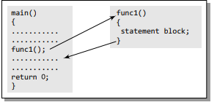
In the figure, we can see that main() calls a function named func1(). Therefore, main() is known as the calling function and func1() is known as the called function. The moment the compiler encounters a function call, the control jumps to the statements that are a part of the called function. After the called function is executed, the control is returned to the calling program

Slide 161
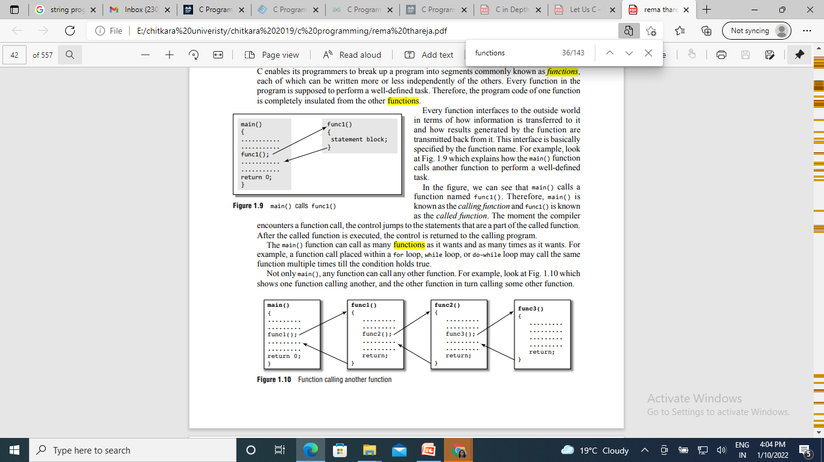

Slide 162
Function Declaration
Before using a function, the compiler must know the number of parameters and the type of parameters that the function expects to receive and the data type of value that it will return to the calling program. Placing the function declaration statement prior to its use enables the compiler to make a check on the arguments used while calling that function
return_data_type function_name(data_type variable1, data_type variable2,..);

Slide 163
Function Definition
When a function is defined, space is allocated for that function in the memory. A function definition comprises of two parts:
Function header
Function body
The syntax of a function definition can be given as:
return_data_type function_name(data_type variable1, data_type variable2,..)
{ .............
statements
.............
return(variable);
}
Note that the number of arguments and the order of arguments in the function header must be the same as that given in the function declaration statement

Slide 164
While return_data_type function_name(data_type variable1, data_type variable2,...) is known as the function header,
the rest of the portion comprising of program statements within the curly brackets { } is the function body which contains the code to perform the specific task.
Note that the function header is same as the function declaration. The only difference between the two is that a function header is not followed by a semi-colon

Slide 165
Function Call
The function call statement invokes the function. When a function is invoked, the compiler jumps to the called function to execute the statements that are a part of that function.
Once the called function is executed, the program control passes back to the calling function.
A function call statement has the following syntax:
function_name(variable1, variable2, ...);

Slide 166
The following points are to be noted while calling a function:
Function name and the number and the type of arguments in the function call must be same as that given in the function declaration and the function header of the function definition. Names (and not the types) of variables in function declaration, function call, and header of function definition may vary.
Arguments may be passed in the form of expressions to the called function. In such a case, arguments are first evaluated and converted to the type of formal parameter and then the body of the function gets executed.
If the return type of the function is not void, then the value returned by the called function may be assigned to some variable as given below
variable_name = function_name(variable1, variable2, ...);

Slide 167
#include<stdio.h>
int evenodd(int); //FUNCTION DECLARATION
int main()
{ int num, flag;
printf("\n Enter the number : ");
scanf("%d", &num);
flag = evenodd(num); //FUNCTION CALL
if (flag == 1)
printf("\n %d is EVEN", num);
else
printf("\n %d is ODD", num);
return 0; }
int evenodd(int a) // FUNCTION HEADER
{ // FUNCTION BODY
if(a%2 == 0)
return 1;
else
retun 0; }

Slide 168
User..Defined Functions
Users can create their own functions for performing any specific task of the program. These types of functions are called user-defined functions.
Function declaration
Function definition .
Function call

Slide 169
#include<stdio.h>
void drawline () ; /*Function Declaration* /
void main( )
{ drawline( ); /*Function Call*/
}
void drawline () / *Function Definition* /
{ int i;
for(i=1;i<=80;i++)
print f (" _ " ) ;
}

Slide 170
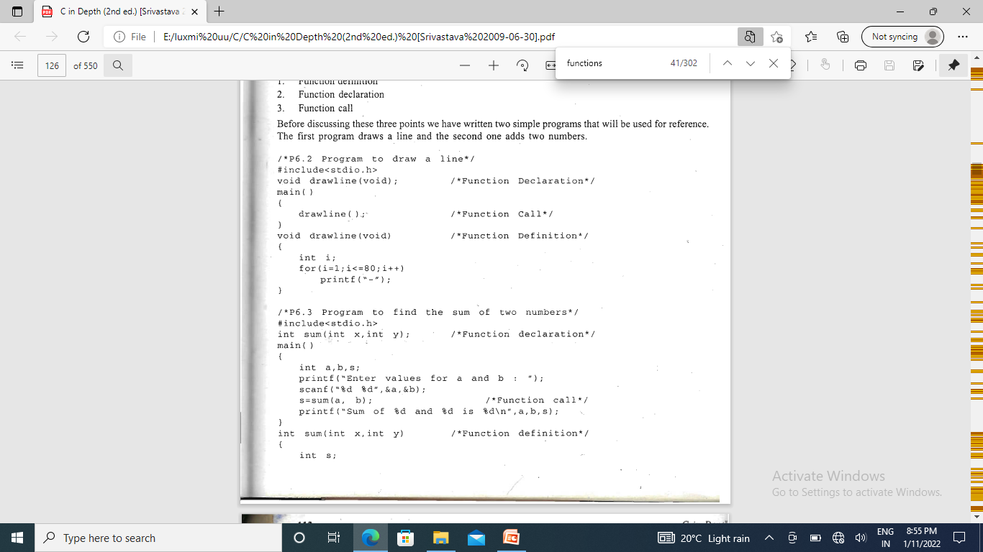
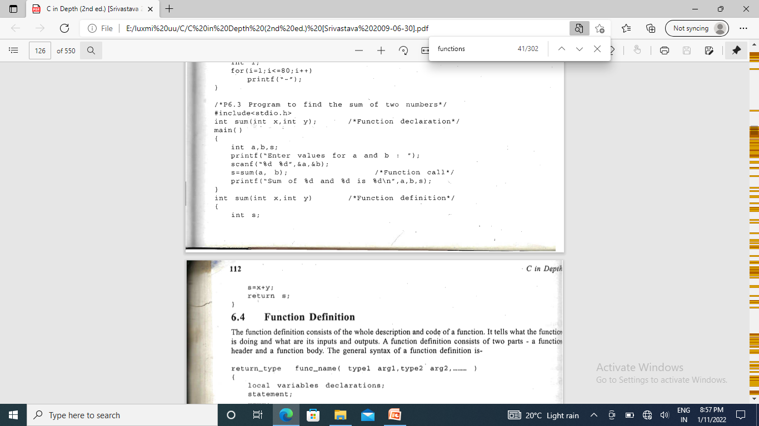

Slide 171
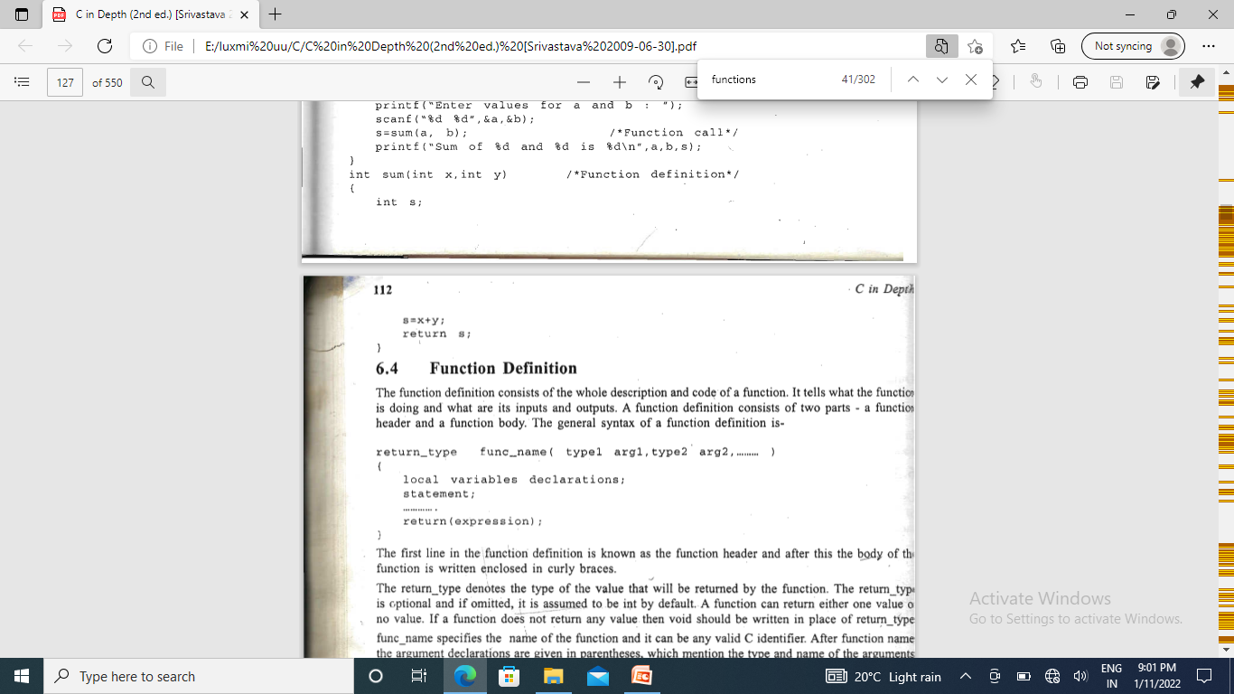
Function Definition
The function definition consists of the whole description and code of a function. It tells what the function is doing and what are its inputs and outputs. A function definition consists of two parts - a function header and a function body. The general syntax of a function definition is

Slide 172
Function Call
The function definition describes what a function can do. A function is ,called by writing its name followed by the argument list inside the parentheses.
func_name(argl, arg2, arg3 ...)
These arguments arg I, arg2, ,...are called actual arguments.

Slide 173
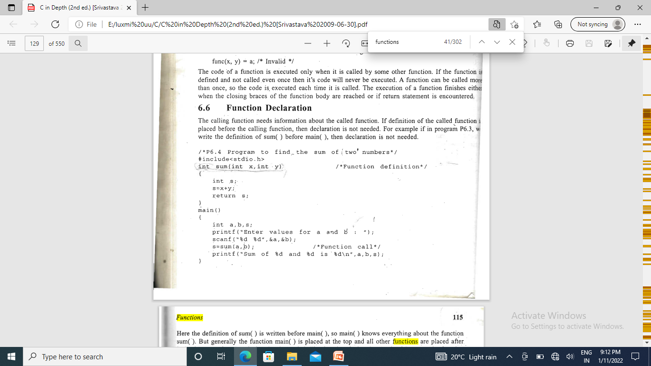
Function Declaration/function prototype
The calling function needs information about the called function. If definition of the called function placed before the calling function, then declaration is not needed.

Slide 174
Function Arguments
The calling function sends some values to the called function for communication; these values are called arguments or parameters.
Actual arguments: The arguments which are mentioned in the function call are known as actual arguments, since these are the values which are actually sent to the called function. Actual arguments can be written in the form of variables, constants or expressions or any function call that returns a value For example- " fun(x), fun(a*b, c*d+k),func( 22, 43 )

Slide 175
Formal arguments
The name of the arguments, which are mentioned in the function definition are called formal or dummy arguments. since they are used just to hold the values that are sent by the calling function. These, formal arguments are simply like other local variables of the function which are created when the function call starts and are destroyed when the function ends.

Slide 176
Call by value
The actual parameter is the argument which is used in the function call whereas formal parameter is the argument which is used in the function definition.
In call by value, different memory is allocated for actual and formal parameters since the value of the actual parameter is copied into the formal parameter
In call by value method, we can not modify the value of the actual parameter by the formal parameter.

Slide 177
#include<stdio.h>
void change(int num)
{
printf("Before adding value inside function num=%d \n",num);
num=num+100;
printf("After adding value inside function num=%d \n", num);
}
void main() {
int x=100;
printf("Before function call x=%d \n", x);
change(x); ;//passing value in function
printf("After function call x=%d \n", x);
}
Output :
Before function call x=100
Before adding value inside function num=100
After adding value inside function num=200
After function call x=100

Slide 178
#include <stdio.h>
void swap(int , int); //prototype of the function
int main()
{
int a = 10;
int b = 20;
printf("Before swapping the values in main a = %d, b = %d\n",a,b); 10,20
swap(a,b);
printf("After swapping values in main a = %d, b = %d\n",a,b); 10,20
}
void swap (int a, int b)
{
int temp;
temp = a;
a=b;
b=temp;
printf("After swapping values in function a = %d, b = %d\n",a,b); 20,10
}
Output

Slide 179
Call by reference
In call by reference, the address of the variable is passed into the function call as the actual parameter.
In call by reference, the memory allocation is similar for both formal parameters and actual parameters. All the operations in the function are performed on the value stored at the address of the actual parameters, and the modified value gets stored at the same address.

Slide 180
#include <stdio.h>
void swap(int *, int *); //prototype of the function
Void main()
{
int a = 10;
int b = 20;
printf("Before swapping the values in main a = %d, b = %d\n",a,b);
swap(&a,&b);
printf("After swapping values in main a = %d, b = %d\n",a,b);
}
void swap (int *a, int *b)
{
int temp;
temp = *a;
*a=*b;
*b=temp;
printf("After swapping values in function a = %d, b = %d\n",*a,*b);
}

Slide 181
#include<stdio.h>
void change(int *num)
{
printf("Before adding value inside function num=%d \n",*num);
*num =*num+100;
printf("After adding value inside function num=%d \n", *num);
}
int main() {
int x=100;
printf("Before function call x=%d \n", x);
change(&x) ;/ /passing reference in function
printf("After function call x=%d \n", x);
}
Output:
Before function call x=100
Before adding value inside function num=100
After adding value inside function num=200
After function call x=200

Slide 182
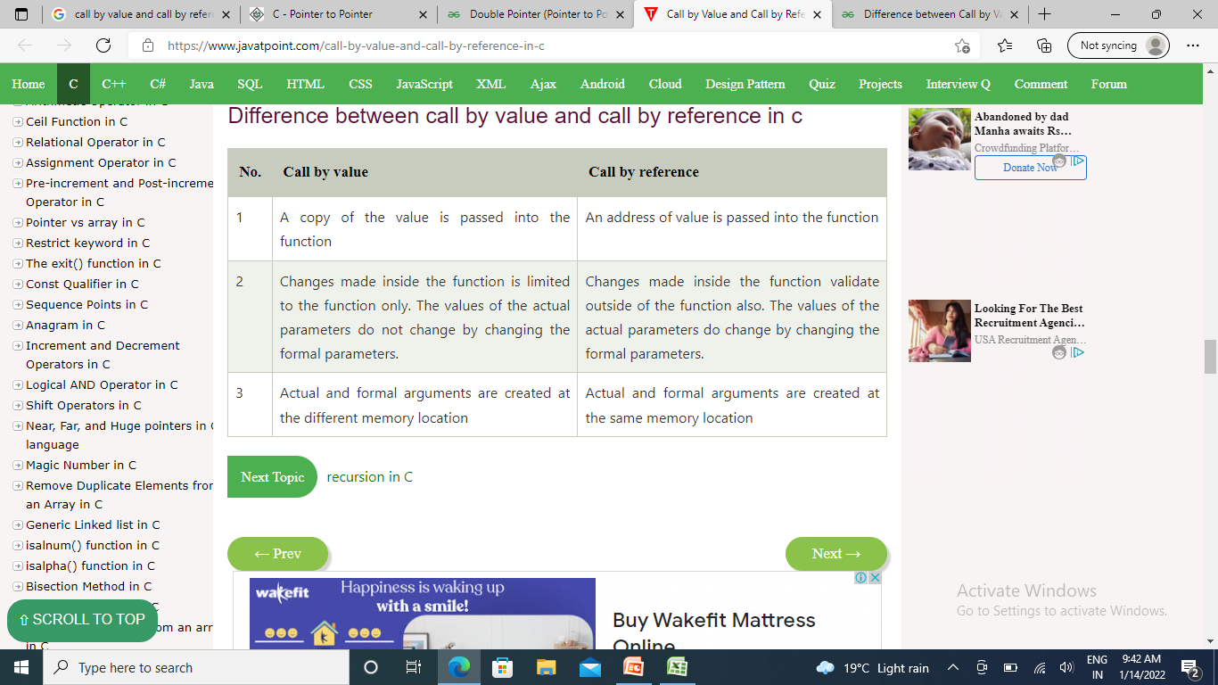

Slide 183
The process of calling a function by itself is called recursion and the function which calls itself is called recursive function
#include<stdio.h>
int factorial(int x)
{
if(x<=1)
{
return 1;
}
return (x * factorial(x-1));
}
int main()
{
int x=5;
printf("Factorial of %d is %dn",x,factorial(x));
return 0;
}

Slide 184
Pointers
The pointer in C language is a variable which stores the address of another variable
type *var-name;
int n = 10;
int *p=&n;
Variable p of type pointer is pointing to the address of the variable n of type integer.

Slide 185
Declaring a pointer
The pointer is declared using * (indirection operator). * is used for
Declaration of a pointer and Returns the value of the referenced variable
int *a; //pointer to int
char *c; //pointer to char
Int *ip; /* pointer to an integer */
double *dp; /* pointer to a double */
float *fp; /* pointer to a float */
char *ch /* pointer to a character */

Slide 186



Slide 187
{ int var = 20;
int *ip;
ip = &var;
printf("Address of var variable: %x\n", &var );
printf("Address stored in ip variable: %x\n", ip );
printf("Value of *ip variable: %d\n", *ip ); }
*(&var) &var is an address, so dereferencing it with *. operator will give the variable at that address and the variable at that address is var. Hence *(&var) is same as writing var
Output :
Address of var variable: bffd8b3c
Address stored in ip variable: bffd8b3c
Value of *ip variable: 20
To access the value stored in the address we use the unary operator (*) that returns the value of the variable located at the address specified by its operand. This is also called Dereferencing.

Slide 188
Incrementing a Pointer
#include <stdio.h>
const int MAX =3;
void main ()
{ int var[] = {10, 100, 200};
int i, *ptr; /* let us have array address in pointer */
ptr = &var;
for ( i = 0; i < MAX; i++)
{ printf("Address of var[%d] = %x\n", i, ptr );
printf("Value of var[%d] = %d\n", i, *ptr ); /* move to the next location */
ptr++; } }
Output
Address of var[0] = bf882b30
Value of var[0] = 10
Address of var[1] = bf882b34
Value of var[1] = 100
Address of var[2] = bf882b38
Value of var[2] = 200
10 | 100 | 200
2b30 | 2b34 | 2b38

Slide 189
10 | 100 | 200
2b30 | 2b34 | 2b38
Decrementing a Pointer
#include <stdio.h>
const int MAX = 3;
int main ()
{ int var[] = {10, 100, 200};
int i, *ptr;
ptr = &var[MAX-1];
for ( i = MAX; i > 0; i--)
{ printf("Address of var[%d] = %x\n", i-1, ptr );
printf("Value of var[%d] = %d\n", i-1, *ptr );
ptr--; } }
Output :
Address of var[2] = bfedbcd8
Value of var[2] = 200
Address of var[1] = bfedbcd4
Value of var[1] = 100
Address of var[0] = bfedbcd0
Value of var[0] = 10

Slide 190
array name is a pointer constant to the first element, the address of the first element and the name of the array both represent the same location in memory.

Slide 191
int main() { int a[]={1,2,3,4}; int *p,i; p=a; for(i=0;i<=3;i++) {printf("%d",*p); p++; }
,

Slide 192

same a &a[0]
a is a pointer only to the first element—not the whole array.

Slide 193


Slide 195
int main() { int a[]={1,2,3,4}; int *p,i,sum=0; p=a; for(i=0;i<=3;i++) {printf("%d",*p); sum=sum+*p; p++; } printf("%d", sum); }
for (p=&a[0];p<=&a[3];p++)
{ sum=sum+*p;
}

Slide 196


Slide 197
int main()
{ int a=5,b=6,c=5;
int *p1=&a;
int *p2=&b;
int *p3=&c;
. if(*p1<*p2)
{ printf("\n%d less than %d",*p1,*p2); }
if(*p2>*p1)
{ printf("\n%d greater than %d",*p2,*p1); }
if(*p3==*p1)
{ printf("\nBoth the values are equal"); }
if(*p3!=*p2)
{ printf("\nBoth the values are not equal"); }
}

Slide 198
int main() {
int n = 10, arr[] = { 1, 20, 3, 40, 50, 60, 70, 80, 90, 100 };
int* ptr;
ptr = arr; // Pointer points the first (0th index) int count_even = 0;
int count_odd = 0;
for (int i = 0; i < n; i++)
{ if (*ptr % 2 == 0)
{ count_even++; }
if (*ptr % 2 != 0)
{ count_odd++; }
ptr++; }
printf("\n No of even elements in an array is : %d", count_even);
printf("\n No of odd elements in an array is : %d", count_odd);

Slide 199
#include <stdio.h>
int main ()
{ int var1;
char var2[10];
printf("Address of var1 variable: %x\n", &var1 );
printf("Address of var2 variable: %x\n", &var2 );
return 0; }
Output
Address of var1 variable: bff5a400
Address of var2 variable: bff5a3f6

Slide 200

Pointer to pointer
A pointer to a pointer is a form of multiple indirection, or a chain of pointers. Normally, a pointer contains the address of a variable. When we define a pointer to a pointer, the first pointer contains the address of the second pointer, which points to the location that contains the actual value
int **var;

Slide 201
#include <stdio.h>
void main ()
{ int a;
int *ptr;
Int **pptr; (pointer to pointer to int
a = 5;
ptr = &a;
pptr = &ptr;
printf("Value of a = %d\n", a );
printf("Value available at *ptr = %d\n", *ptr );
printf("Value available at **pptr = %d\n", **pptr);
}
Output
Value of a = 5
Value available at *ptr = 5
Value available at **pptr = 5
a
3000
5
2002
ptr
2002
3003

Slide 202

Array of Pointers
data_type *name_of_array [array_size];
int *arr[5]

Slide 203
#include<stdio.h> #define SIZE 10 void main() { int *arr[3]; int p = 40, q = 60, r = 90, i; arr[0] = &p; arr[1] = &q; arr[2] = &r; for(i = 0; i < 3; i++) {printf("for address %p \n", arr[i]); printf("value is %d\n",*arr[i]);} }

Slide 204
#include <stdio.h>
main()
{
int x, y;
int *ptr;
x = 10 ;
ptr = &x ;
y = *ptr ;
printf (“%d is stored in location %u \n”, x, &x) ;
printf (“%d is stored in location %u \n”, *&x, &x) ;
printf (“%d is stored in location %u \n”, *ptr, ptr) ;
printf (“%d is stored in location %u \n”, y, &*ptr) ;
printf (“%u is stored in location %u \n”, ptr, &ptr) ;
printf (“%d is stored in location %u \n”, y, &y) ;
*ptr = 25;
printf (“\nNow x = %d \n”, x);
}
*&x⬄x
ptr=&x;
&x⬄&*ptr

Slide 205
Output:
10 is stored in location 3221224908
10 is stored in location 3221224908
10 is stored in location 3221224908
10 is stored in location 3221224908
3221224908 is stored in location 3221224900
10 is stored in location 3221224904
Now x = 25
Address of x: 3221224908
Address of y: 3221224904
Address of ptr: 3221224900

Slide 206

Types of pointers
Dangling Pointer
Dangling pointers are pointers that pointing to a memory location that has been deleted (or freed).
The pointers pointing to a deallocated memory block are known as Dangling Pointers.
There are ways to avoid Dangling Pointer Problems like assigning NULL to the pointer when the memory gets deallocated

Slide 207
Dangling pointer occurs at the time of the object destruction when the object is deleted or de-allocated from memory without modifying the value of the pointer. In this case, the pointer is pointing to the memory, which is de-allocated.
The dangling pointer can point to the memory, which contains either the program code or the code of the operating system.
If we assign the value to this pointer, then it overwrites the value of the program code or operating system instructions; in such cases, the program will show the undesirable result or may even crash.

Slide 208
In Dynamic Memory Allocation, generally, we use malloc(), calloc() functions to allocate a memory block and free() function to deallocate a memory block in C Language. once we deallocate a memory block using the free() function, a Dangling Pointer is generated.
#include<stdio.h>
#include<stdlib.h> //for free() function
int main()
{
int *ptr = (int *)malloc(sizeof(int)); // normal pointer
*ptr = 10;
free(ptr); // ptr acts as a dangling pointer
printf("%d", *ptr); // prints garbage value in the output console
}

Slide 209



#include <stdio.h>
int main()
{
int *ptr=(int *)malloc(sizeof(int));
int a=560;
ptr=&a;
free(ptr);
return 0;
}
int *ptr=(int *)malloc(sizeof(int)); will allocate the memory with 4 bytes shown in the below image:
The statement free(ptr) de-allocates the memory
'ptr' pointer becomes dangling as it is pointing to the de-allocated memory.
If we assign the NULL value to the 'ptr', then 'ptr' will not point to the deleted memory. Therefore, we can say that ptr is not a dangling pointer,

Slide 210
NULL Pointer
A pointer that is not assigned any value but NULL is known as the NULL pointer.
If you don't have any address to be specified in the pointer at the time of declaration, you can assign NULL value. A null pointer always contains value 0. int *p=NULL;
#include <stdio.h>
int main()
{ int *ptr = NULL; //null pointer
printf("value of ptr is %d",ptr);
printf("address of ptr is %x",&ptr);
return 0;
}
Output :
value of ptr is 0
address of ptr is c2df2f10

Slide 211
Void Pointer
It is a pointer that has no associated data type with it. A void pointer can hold addresses of any type and can be typecast to any type. Also called generic pointer. Declared with keyword void.
void *p
#include <stdio.h>
int main()
{
void *p = NULL; //void pointer
printf("The size of pointer is:%d ",sizeof(p)); //size of p depends on compiler
return 0;}
Output is 8

Slide 212
Wild Pointer
Wild pointers are also called uninitialized pointers. Because they point to some arbitrary memory location and may cause a program to crash or behave badly.
This type of C pointer is not efficient. Because they may point to some unknown memory location which may cause problems in our program. This may lead to the crashing of the program.
int main()
{ int *pt; //wild pointer
printf("%d",*pt);
return 0;
}

Slide 213
Memory management
Dynamic memory allocation
Functions: malloc, calloc, realloc
De-allocating memory
Functions: free

Slide 214
Dynamic memory allocation
.
static memory allocation memory is allocated at compile time. memory can't be increased while executing program.
Dynamic memory allocation – Memory is allocated at run time. memory can be increased while executing program., used in linked list.
malloc() | allocates single block of requested memory.
calloc() | allocates multiple block of requested memory.
realloc() | reallocates the memory occupied by malloc() or calloc() functions.
free() | frees the dynamically allocated memory.

Slide 215
Stdlib.h
malloc() | Allocates the memory of requested size and returns the pointer to the first byte of allocated space.
calloc() | Allocates the space for elements of an array. Initializes the elements to zero and returns a pointer to the memory.
realloc() | It is used to modify the size of previously allocated memory space.
Free() | Frees or empties the previously allocated memory space.

Slide 216
malloc() function
Allocates the memory of requested size and returns the pointer to the first byte of allocated space. It returns NULL if memory is not sufficient.
void *malloc (size)
Returns a void pointer to a contiguous block in memory of size equal to size bytes. Size is always taken to be in bytes.
On success returns pointer (address of beginning of block of memory just created).
Why is a void pointer returned ???
malloc just allocates memory which consists of some number of bytes. Memory as such has no data type, unless the user or the running program chooses to associate a data type with the block of memory just created.
ptr=(cast-type*)malloc(byte-size)
ptr is a pointer of cast_type. The malloc() function returns a pointer to the allocated memory of byte_size.

Slide 217
Allocated space is not initialized, so contains garbage. No connection exists with type of data to be stored in the memory space just created. Contained in the header file: stdlib.h or alloc.h
How to assign a data type to the memory just created ???
Use type casting.
Once type cast to a data type, memory takes on the meaning of that data type.
Amount of data types that can be represented depends on the size of the data type.
double *x;
x = (double *) malloc (100 * sizeof (double));
This is the correct declaration, gives us 800 bytes in memory, where we have 100 doubles.
Always better to use sizeof instead of the following:
x = (double *)malloc (100 * 8); // assume that double is 8 bytes

Slide 218
#include <stdio.h>
#include<stdlib.h>
int main()
{ int *p, n,i;
scanf("%d",&n); 5
p=(int *)malloc (n*sizeof(int));
if(p==NULL)
{printf("memory not allocated");
exit(0);}
for(i=0;i<n;i++)
{printf("enter the values");
scanf("%d", p+i);} 1,2,3,4,5
for(i=0;i<n;i++)
{printf("value entered are");
printf("%d", *(p+i)); 1,2,3,4,5
} return 0;}

Slide 219
#include<stdio.h>
#include <stdlib.h>
void main()
{
int *ptr;
ptr = malloc(10 * sizeof(*ptr)); /* a block of 10 integers */
if (ptr != NULL)
{ *(ptr + 5) = 520; /* assign 520 to fifth integer */
printf("Value of the 5th integer is %d",*(ptr + 5));
}
}
Output
Value of the 5th integer is 520
if(ptr==NULL)
{
printf("Sorry! unable to allocate memory");
exit(0); }

Slide 220
Calloc()
The calloc( ) function is used to allocate multiple blocks of memory. It is somewhat similar to malloc( ) function except for two differences. The first one is that it takes two arguments. The first argument specifies the number of blocks and the second one specifies the size of each block.
For exampleptr = ( int * ) calloc ( 5 , sizeof(int));
Allocated space is automatically initialized to zero.
Still have to cast void pointer to correct type.
int *x;
x = (int *) calloc (10, sizeof (int));
Gives us a block of 10 integers in memory.
char *x;
x = (char *) calloc (10, sizeof (char));
Gives us a block of 10 characters in memory.

Slide 221
realloc()
used to increase or decrease the memory .allocated by malloc( ) or calloc( ).
The function realloc( ) is used to change the size of the memory block. It alters the size of the memory block without losing the old data. This is known as reallocation of memory
This function takes two arguments, first is a pointer to the block of memory that was previously allocated by malloc( ) or calloc( ) and second one is the new size for that block.
For example ptr = (int *) malloc ( size );
This statement allocates the memory of the specified size and starting address of this memory block is stored in the pointer variable ptr. If we :want to change the size of this memory block, then we can use realloc().
ptr = (int *) realloc ( ptr , newsize );

Slide 222
#include <stdio.h>
#include<stdlib.h>
void main()
{ int *p, *ptr,i;
p=(int *)malloc(5*sizeof(int)); //memory allocated for 5 integers
if(p==NULL)
{printf("memory not allocated");
exit(0);}
for(i=0;i<5;i++)
{printf("enter the values");
scanf("%d", p+i);}
ptr= (int *) realloc (p, 9 *sizeof (int) ); //memory allocated for 4 more integers
if (ptr==NULL){printf ("Memory not available\n");exit(0); }
printf ("Enter 4 more integers");
for(i=5;i<9;i++)
scanf("%d",ptr+i);
for(i=0;i<9;i++)
printf ("%d ", *(ptr+i));
}

Slide 223
free()
The dynamically allocated memory is not automatically released; it will exist till the end of program. If we have finished working with the memory allocated dynamically, it is our responsibility to release that memory so that it can be reused. The function free( ) is used to release the memory space allocated dynamically. The memory released by free( ) is made available to the heap again and can be used for some other purpose
free(ptr).

Slide 224
Structures

Slide 225
Why Use Structures
For example, suppose you want to store data about 3 books. You might want to store name (a string), price (a float) and number of pages in each book (an int).

Slide 226
There are 2 approaches for this:
Construct individual arrays, one for storing names, another for storing prices and still another for storing number of pages.
Use a structure variable.

Slide 227
Approach No1.
void main()
{
char name[3] ;
float price[3] ;
int pages[3], i ;
printf ( "\nEnter names, prices and no. of pages of 3 books\n" ) ;
for ( i = 0 ; i <= 2 ; i++ )
scanf ( "%c %f %d", &name[i], &price[i], &pages[i] );
printf ( "\nAnd this is what you entered\n" ) ;
for ( i = 0 ; i <= 2 ; i++ )
printf ( "%c %f %d\n", name[i], price[i], pages[i] );
}

Slide 228
OUTPUT: Enter names, prices and no. of pages of 3 books A 100.00 354 C 256.50 682 F 233.70 512 And this is what you entered A 100.000000 354 C 256.500000 682 F 233.700000 512

Slide 229
Approach No.2
main( )
{
struct book
{
char name ;
float price ;
int pages ;
} ;
struct book b1, b2, b3 ;
printf ( "\nEnter names, prices & no. of pages of 3 books\n" ) ;
scanf ( "%s %f %d", b1.name, &b1.price, &b1.pages ) ;
scanf ( "%s %f %d", &b2.name, &b2.price, &b2.pages ) ;
scanf ( "%cs%f %d", &b3.name, &b3.price, &b3.pages ) ;
printf ( "\nAnd this is what you entered" ) ;
printf ( "\n%c %f %d", b1.name, b1.price, b1.pages ) ;
printf ( "\n%c %f %d", b2.name, b2.price, b2.pages ) ;
printf ( "\n%c %f %d", b3.name, b3.price, b3.pages ) ;
}

Slide 230
OUTPUT: Enter names, prices and no. of pages of 3 books A 100.00 354 C 256.50 682 F 233.70 512 And this is what you entered A 100.000000 354 C 256.500000 682 F 233.700000 512

Slide 231
Declaring and instantiating a Structure
struct book { char name ; float price ; int pages ; } ; struct book b1, b2, b3 ; | struct book { char name ; float price ; int pages ; } b1, b2, b3 ;
All above mentioned declarations are same

Slide 232
Initializing a structure: struct book { char name[10] ; float price ; int pages ; } ; struct book b1 = { "Basic", 130.00, 550 } ; struct book b2 = { "Physics", 150.80, 800 } ;

Slide 233
Memory Representation
b1.name
b1.price
b1.pages
“Basic” | 130.00 | 550
<100>
<110>
<114>

Slide 234
Copying one structure instance to another
main( )
{ struct employee
{
char name[10] ;
int age ;
float salary ;
} ;
struct employee e1 = { "Sanjay", 30, 5500.50 } ;
struct employee e2, e3 ;
/* piece-meal copying */
strcpy ( e2.name, e1.name ) ;
e2.age = e1.age ;
e2.salary = e1.salary ;
/* copying all elements at one go */
e3 = e2 ;
printf ( "\n%s %d %f", e1.name, e1.age, e1.salary ) ;
printf ( "\n%s %d %f", e2.name, e2.age, e2.salary ) ;
printf ( "\n%s %d %f", e3.name, e3.age, e3.salary ) ;
}

Slide 235
Array of Structures
In our sample program, to store data of 100 books we would be required to use 100 different structure variables from b1 to b100, which is definitely not very convenient. A better approach would be to use an array of structures.

Slide 236
main( ) { struct book { char name ; float price ; int pages ; } ; struct book b[100] ; int i ; for ( i = 0 ; i <= 99 ; i++ ) { printf ( "\nEnter name, price and pages " ) ; scanf ( "%c %f %d", &b[i].name, &b[i].price, &b[i].pages ) ; fflush(stdin); } for ( i = 0 ; i <= 99 ; i++ ) printf ( "\n%c %f %d", b[i].name, b[i].price, b[i].pages ) ; }

Slide 237
Passing Structure to a function via Call by Value
struct book
{
char name[25] ;
char author[25] ;
int callno ;
} ;
main( )
{
struct book b1 = { "Let us C", "YPK", 101 } ;
display ( b1 ) ;
}
display ( struct book b )
{
printf ( "\n%s %s %d", b.name, b.author, b.callno ) ;
}

Slide 238
Passing Structure to a function via Call by Reference
struct book
{
char name[25] ;
char author[25] ;
int callno ;
} ;
main( )
{
struct book b1 = { "Let us C", "YPK", 101 } ;
display ( &b1 ) ;
}
display ( struct book *b )
{
printf ( "\n%s %s %d", b->name, b->author, b->callno ) ;
}

Slide 239
Pointer to structure
#include<stdio.h>
struct student
{ int sno;
char sname[30];
float marks;
};
void main ( )
{ struct student s;
struct student *st;
printf("enter sno, sname, marks:");
scanf ("%d%s%f", &s.sno, s.sname, &s.marks);
st = &s;
printf ("details of the student are");
printf ("Number = %d", st ->sno);
printf ("name = %s", st->sname);
printf ("marks =%f", st ->marks);
}
can write- . ... (*ptr).sno (*ptr).sname (*ptr).marks Here parentheses are necessary because dot operator has higher precedence than the * operator.

Slide 240
Ptr-> membername;
The members of the structure can be accessed using a special operator called as an arrow operator ( -> ).
Declaration
struct student *ptr
Ptr->membername

Slide 241
struct Employee
{ char name[50];
int age;
float salary;
}employee_one;
struct Employee *employee_ptr;

Slide 242
Unions are like structures except they use less memory. If you create a structure with a double that is 8 bytes and an integer that is 2 bytes then the total memory size required to store them will only be 10 bytes
. But if create a union it will demand only 8 bytes of memory.(As memory is allocated only for the largest element in the union). All members of union in turn share memory. This is because they overwrite each other and the last one stored will be available in memory.

Slide 243
#include <stdio.h>
union Data
{ int i;
float f;
char str[20];
};
void main( )
{ union Data d;
printf( "Memory size occupied by data : %d\n", sizeof(d));}
Memory size occupied by data : 20

Slide 244
File handling
Files are used to store data in a manner that can later be retrieved and displayed especially in large volumes. It is used to store the information permanently and to access information whenever necessary.
Files are stored in the Secondary Storage Devices like Floppy Disks, Hard Disks.
Types of files
1) Text Files (Stream-oriented data files) - The data is stored in the same manner as it appears on the screen. Text files are the normal .txt files. Stores textual information like alphabets, numbers, special symbols .etc.,
Ex: A-Z, a-z, 1,2,3…etc., : , ; , ” , ’ , ? etc.
2) Binary Files (System-oriented data files)- Any files which store the data in the form of bytes is a binary file. closely associated with the OS and data stored in memory without converting into text format.

Slide 245
File handling in C enables us to create, update, read, and delete the files stored on the local file system through our C program. The following operations can be performed on a file.
Creation of the new file
Opening an existing file
Reading from the file
Writing to the file
Deleting the file

Slide 246
Write to a text file #include <stdio.h> #include <stdlib.h> int main() { int num; FILE *fptr; fptr = fopen("C:\\first.txt","w"); if(fptr == NULL) { printf("Error!"); exit(1); } printf("Enter num: "); scanf("%d",&num);
fprintf(fptr,"%d",num); //write data into the file
fclose(fptr);
return 0;}

Slide 247
#include <stdio.h> #include <stdlib.h> int main() { int num; FILE *fptr; if ((fptr = fopen("C:\\first.txt","r")) == NULL) { printf("Error! opening file"); exit(1); } fscanf(fptr,"%d", &num); // reads data from the file printf("Value of n=%d", num); fclose(fptr); return 0;}

Slide 248
fopen() modes
Mode | Description
r | It opens an existing text file.
w | It opens a text file for writing; a new file is created if the file doesn't exist.
a | It opens a text file for appending(writing at the end of an existing file) and creates the file if it does not exist.
r+ | It opens a text file for reading and writing.
w+ | It opens a text file for reading and writing, creates the file if it does not exist, and empties it if it already exists.
a+ | It opens a text file for reading and appending and creates the file if it doesn't exist. Reading starts from the beginning, but writing can only append.

Slide 249
Mode | Description
rb | Open for reading in binary mode. If the file does not exist, fopen( ) returns NULL.
wb | Open for writing in binary mode. If the file exists, its contents are overwritten. If the file does not exist, it will be created.
ab | Open for append in binary mode. Data is added to the end of the file. If the file does not exist, it will be created.
rb+ | Open for both reading and writing in binary mode. If the file does not exist, fopen( ) returns NULL.
wb+ | Open for both reading and writing in binary mode. If the file exists, its contents are overwritten. If the file does not exist, it will be created.
ab+ | Open for both reading and appending in binary mode. If the file does not exist, it will be created.

Slide 250
Functions for file handling
fopen() | opens new or existing file
fprintf() | write data into the file
fscanf() | reads data from the file
fputc() | writes a character into the file
fgetc() | reads a character from file
fclose() | closes the file
fseek() | sets the file pointer to given position
fputw() | writes an integer to file
fgetw() | reads an integer from file
ftell() | returns current position
rewind() | sets the file pointer to the beginning of the file

Slide 251
void main() { FILE *fptr; int id; char name[30]; float salary; fptr = fopen("emp.txt", "w+"); /* open for writing */ if (fptr == NULL) { printf("File does not exists \n"); return; }
printf("Enter the id\n"); scanf("%d", &id);
fprintf(fptr, "Id= %d\n", id);
printf("Enter the name \n"); scanf("%s", name);
fprintf(fptr, "Name= %s\n", name);
printf("Enter the salary\n"); scanf("%f", &salary);
fprintf(fptr, "Salary= %f\n", salary);
fclose(fptr);
}

Slide 252
Block read/write (fwrite() ,fread())
size_t fwrite(const void *ptr, size_t size, size_t n, FILE *fp);
The fwrite() function writes the data specified by the void pointer ptr to the file.
ptr: it points to the block of memory which contains the data items to be written.
size: It specifies the number of bytes of each item to be written.
n: It is the number of items to be written.
fp: It is a pointer to the file where data items will be written.
int arr[3] = {101, 203, 303};
fwrite(arr, sizeof(arr), 1, fp); // writes the entire array into the file.
fwrite(arr, sizeof(int), 2, fp); // writes only the first two elements of the array into the file.

Slide 253
struct stu { char name[10]; int roll; float marks; }; struct stud students[3] = { {“Anay", 10, 80.5}, {“Vijay", 11, 71.2}, {“Ria", 12, 85.5} }; fwrite(students, sizeof(students), 1, fp);
Writing array of structure

Slide 254
struct employee
{ char name[50];
char designation[50];
int age;
float salary;
} emp;
int main()
{ int n, i, chars;
FILE *fp;
fp = fopen("employee.txt", "wb");
if(fp == NULL)
{ printf("Error opening file\n");
exit(1);
}
printf("Testing fwrite() function: \n\n");
printf("Enter the number of records you want to enter: ");
scanf("%d", &n);
for(i = 0; i < n; i++)
{ printf("\nEnter details of employee %d \n", i + 1);
fflush(stdin);

Slide 255
printf("Name: ");
scanf("%s",emp.name);
printf("Designation: ");
scanf("%s",emp.designation);
printf("Age: ");
scanf("%d", &emp.age);
printf("Salary: ");
scanf("%f", &emp.salary);
chars = fwrite(&emp, sizeof(emp), 1, fp);
printf("Number of items written to the file: %d\n", chars);
}
fclose(fp);
return 0;
}

Slide 256
#include<stdio.h>
#include<stdlib.h>
struct employee
{ char name[50];
char designation[50];
int age;
float salary } emp;
int main()
{ FILE *fp;
fp = fopen("employee.txt", "rb");
if(fp == NULL)
{ printf("Error opening file\n");
exit(1);
}
printf("Testing fread() function: \n\n");
Notes:
Example of fread

Slide 257
while( fread(&emp, sizeof(emp), 1, fp) == 1 ) // reading the records until there are no records in file
{
printf("Name: %s \n", emp.name);
printf("Designation: %s \n", emp.designation);
printf("Age: %d \n", emp.age);
printf("Salary: %.2f \n\n", emp.salary);
}
fclose(fp);
return 0;
}

Slide 258
Random Access Files
Functions that help in accessing only a particular part of the file: (not reading & writing sequentially).
ftell ( ) - It returns the current position of the file ptr.
rewind ( )-It makes file ptr move to beginning of the file.

Slide 259
fseek ( ) -It is to make the file pntr point to a particular location in a file.
fseek(file pointer, offset, position);
Offset
The no of positions to be moved while reading or writing.
If can be either negative (or) positive.
Positive - forward direction.
Negative – backward direction.
Position
SEEK_END: End of the file.
SEEK_SET: Beginning of the file.
SEEK_CUR: Current position of the file pointer

Slide 260
fseek(), ftell(), and rewind() example
#include <stdio.h>
int main ()
{ FILE *fp; int c;
fp = fopen("file.txt","w+");
fputs("random access files", fp);
// fseek() to shift the file pointer to the 7th position.
fseek( fp, 7, SEEK_SET );
//overwrite C programming in the 7th position
fputs(" C Programming", fp);
//Now we print the current position of the file pointer using ftell()
printf("The current position of the file pointer is: %ld\n", ftell(fp));

Slide 261
//We take the file pointer to the beginning of the file.
rewind(fp);
//Now we verify if rewind() worked using ftell().
printf("The current position of the file pointer is: %ld\n", ftell(fp));
while(1)
{
c = fgetc(fp);
if( feof(fp) ) {
break;
}
printf("%c", c);
}
fclose(fp);
return(0); }
output
The current position of the file pointer is: 20
The current position of the file pointer is: 0
random C Programming

Slide 262
Command Line Arguments
When the main function of a program contains arguments, then these arguments are known as Command Line Arguments.
The main function can be created with two methods: first with no parameters (void) and second with two parameters. The parameters are argc and argv, where argc is an integer and the argv is a list of command line arguments.
int main(int argc, char* argv[])
argc (ARGument Count) denotes the number of arguments to be passed
argv[ ] (ARGument Vector) denotes a pointer array pointing to every argument that has been passed to your program.
argc denotes the number of arguments given, while argv[] is a pointer array pointing to each parameter passed to the program. If no argument is given, the value of argc will be 1.

Slide 263

#include <stdio.h> int main(int argc, char *argv[]) { int i; printf("\nProgram name: %s", argv[0]); // argv[0] holds the name of the program.
if (argc < 2) { printf("\n\nNo argument passed through command line!"); } else { printf("\nArgument supplied: ");
for (i = 1; i < argc; i++)
{ printf("%s\t", argv[i]); }
}
}
In case of no arguments
Output :
Program name: c\prj\program.c
No argument passed through command line!

Slide 264

Preprocessor Directives
#define
#define is used to create symbolic constants (known as macros) in C programming language.
define PI 3.14 //object like micro
Function – like macros
#include
#include is used to insert specific header file into C program.
#include <stdio.h>
#include”file”

Slide 265
#undef token
To cancel the definition of a macro means it is undefined and is preceded with #undef directive.
#include <stdio.h>
#include PI 3.14
#undef PI
int main()
{
printf("%f",PI);
return 0;
}
main.c:15:15: error: ‘PI’ undeclared (first use in this function) 15 | printf("%f",PI);

Slide 266

#if, #else, #endif

Slide 267
#pragma
This directive is a special purpose directive and is used to turn on or off some features. These types of directives are compiler-specific i.e., they vary from compiler to compiler.
#pragma startup and #pragma exit: These directives helps us to specify the functions that are needed to run before program startup( before the control passes to main()) and just before program exit (just before the control returns from main()).
Notes:
Output maximum betwee 10 and 20 is 20

Slide 268
#include<stdio.h>
void func1();
void func2();
#pragma startup func1
#pragma exit func2
void func1()
{
printf("Inside func1()\n");
}
void func2()
{
printf("Inside func2()\n");
}
int main()
{
printf("Inside main()\n");
return 0;
}
Output :
Inside func1()
Inside main()
Inside func2(

Slide 269
#include <stdio.h>int main()
{ printf("Current time: %s",__TIME__);
return 0;}

